Slide 1
Endangered Species Research Natural Resources Program Government Affairs and Programs Division

Slide 2
Natural Resources Program Overview
The mission of the Natural Resources program is to provide data that inform Endangered Species Act (ESA) decisions and voluntary conservation efforts.
To support this mission, the program administers state funds to contract with Texas public universities to research species of interest, including petitioned, proposed, and listed species.
The final deliverables are publicly accessible, and used by natural resources managers, local governments, businesses and scientists.
Private landowner information is protected by the Comptroller’s office and its contractors in compliance with Texas Government Code §403.454.

Slide 3
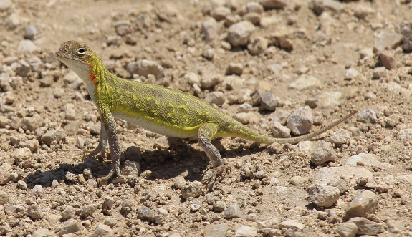
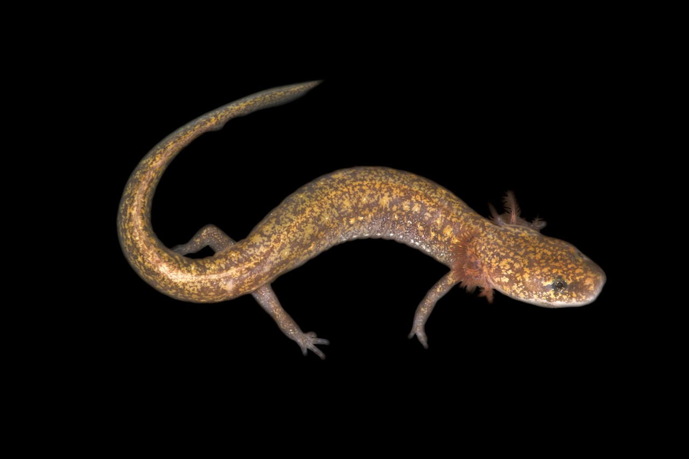
Ongoing Research
Spot-tailed earless lizards
Eurycea salamanders
East Texas mussels
Alligator snapping turtle
Native bees
Bats
Concho and Brazos water snakes
Brazos River shiners
Diamondback terrapin
Texas tortoise

Slide 4
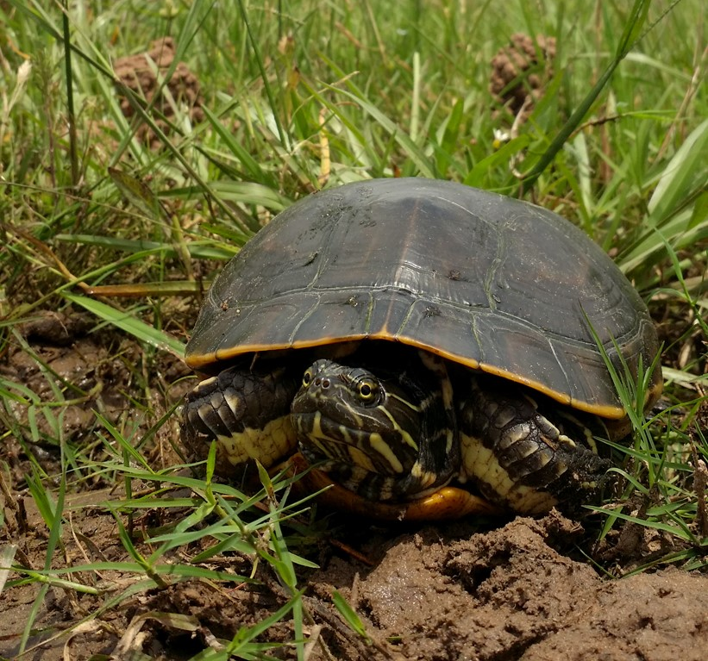
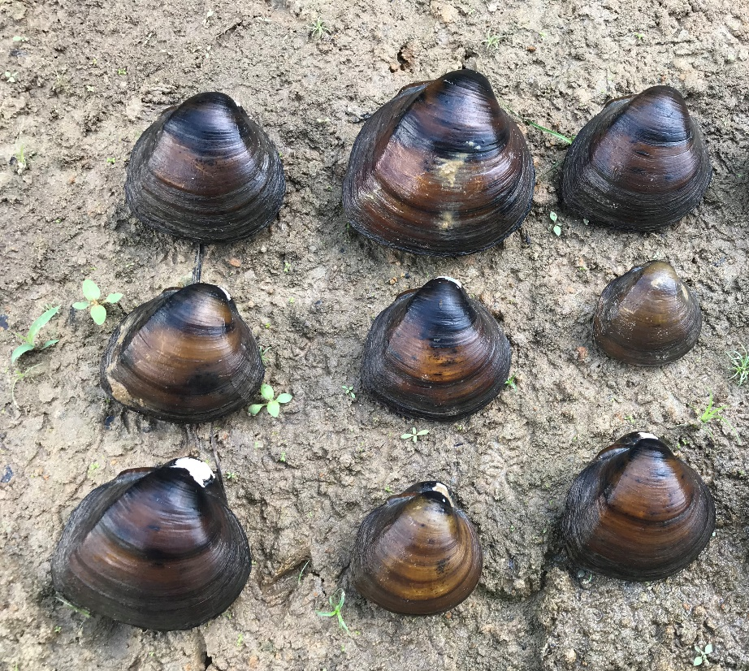
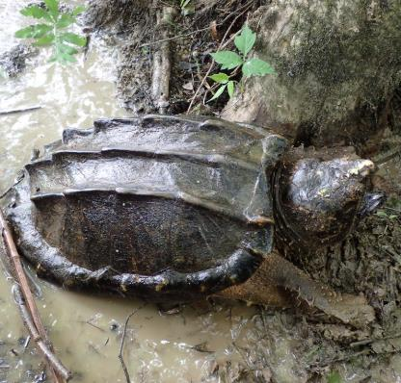
Completed Research
Alligator snapping turtle
East Texas mussels
Plains spotted skunk
Texas kangaroo rat
Western chicken turtle
Black spotted newt
Matagorda Bay ecosystem

Slide 5
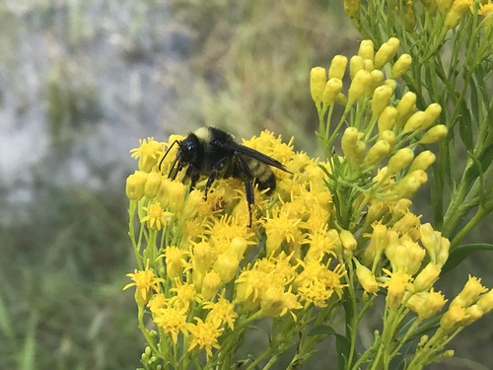
Upcoming Research
Variable cuckoo bumble bee
Survey methods, detection
Morrison and Southern plains bumble bees
Distribution and population size, floral resources, genetic diversity
Kisatchie crayfish
Distribution, habitat association, genetics
Prairie chub
Life history, fish community assessment, tolerances
Open CFP
All species of interest

Slide 6
FWS Workplan – Proposed Listing Decisions
FY24
Spot-tailed earless lizards
Texas salamander
Texas water slater
Monarch
Mimic cave snail
Edwards aquifer diving beetle
Pecos pupfish
FY25
Frosted elfin butterfly
Western chicken turtle
FY26
American bumble bee
Variable cuckoo bumble bee
Morrison bumble bee
Southern plains bumble bee
Black spotted newt
Kisatchie painted crayfish
Golden-winged warbler
Rio Grande shiner

Slide 7
Natural Resources Contacts
Meghan Hope
Director
(512) 936-8554
Melissa Salmon
Contract Administration Supervisor
(512) 463-4676
Jacob Jackson
Senior Research Analyst
(512) 463-4721
Danielle Bucklin
Endangered Species Research Analyst
(512) 305-8607
Lee Schoech
Aquatic Species Research Analyst
(512) 475-1055

Slide 8
Comptroller.texas.gov/programs/natural-resources/

