Slide 1
The Changing Definition of WOTUS: EPA’s 2023 Final Rule – Issued Sept. 8, 2023 Conforming with Sackett v EPA
Texas Water Conservation Association
Fall Conference
September 14, 2023

Slide 2
Clean Water Act
SEC. 101 (a) The objective of this Act is to restore and maintain the chemical, physical, and biological integrity of the Nation's waters.
SEC. 502 (7) The term ‘‘navigable waters’’ means the waters of the United States, including the territorial seas.
Waters of the United States?

Slide 4
Historical Categories

Slide 5
Historical Categories
State Line

Slide 6
Historical Categories
State Line

Slide 7
Historical Categories
State Line

Slide 8
Historical Categories
State Line

Slide 9
Historical Categories
State Line

Slide 10
Historical Categories
State Line

Slide 11
Historical Categories
State Line

Slide 12
Historical Categories
State Line

Slide 13
Historical Categories
State Line

Slide 14
Historical Categories
State Line

Slide 15
Historical Categories
State Line

Slide 16
Historical Categories
State Line

Slide 17
Historical Categories
State Line

Slide 18
Historical Categories
Influenced by:
Riverside Bayview (1985)
State Line

Slide 19
Historical Categories
Influenced by:
Riverside Bayview (1985)
EPA Definition (1986)
State Line

Slide 20
Historical Categories
Influenced by:
Riverside Bayview (1985)
EPA Definition (1986)
SWANCC (2001)
State Line

Slide 21
Historical Categories
Influenced by:
Riverside Bayview (1985)
EPA Definition (1986)
SWANCC (2001)
Rapanos (2006)
State Line

Slide 22
a
Issued December 2, 2008
- Guidance
(Relatively Permanent)
(Significant Nexus)
State Line

Slide 23
Issued August 28, 2015
Repealed September 12, 2019
- Clean Water Rule
State Line

Slide 24
Issued April 21, 2020
Vacated August 30, 2021
State Line

Slide 25
Paragraph (a) includes:
(1) (i) Traditional Navigable Waters, (ii) Territorial Seas, (iii) Interstate Waters
Issued January 18, 2023
Currently under injunction in 27 states
Biden EPA (Step 1) FINAL RULE
(4iii)
(5ii)
(2) Impoundments
- of WOTUS
(4iii)
(5ii)?
(4i)
(3ii)
(3) Tributaries
of (1) or (2)
(i) RP
(ii) SN
(4iii)
(4i)
(4iii)
(3i), (3ii) or NJD
(4iii)
(4) Wetlands
(i) Adjacent to (1)
(ii) Adjacent to RP (2) or (3) + CSC
(iii) Adjacent to (2) or (3) + SN
(3ii)
(3i)
(4ii)
(3ii)
(2)
(5ii)
(4ii), (4iii), (5i) or (5ii)
(3ii)
(3ii)
(5) Intrastate Lakes & Ponds, Streams or Wetlands
(i) RP + CSC to (1) or (3)(i)
(ii) SN
(2)
(5ii)
(4i)
(3i)
(3i)
(2)
(5ii)
(4ii)
(3ii)
State Line
(1iii)
RP = Relatively Permanent
SN = Significant Nexus
CSC = Continuous Surface Connection
(1i)
(4i)
*No categorical significant nexus determinations per preamble
(1ii)
Notes:
3 OTHER WATERS: Intrastate lakes, rivers, streams (including intermittent streams), mudflats, sandflats, wetlands, sloughs, prairie potholes, wet meadows, playa lakes, or natural ponds.
Must meet relatively permanent standard AND “significantly affect” standard
CASE SPECIFIC ANALYSIS NEEDED
4 IMPOUNDMENTS: poorly worded, appears that impoundments of intermittent streams won’t be jurisdictional (an (a)(3) water.
*No categorical significant nexus determinations per preamble
BUT, replaced with “significantly affect” language which is defined exactly like the Significant Nexus Analysis, but is described to more broadly to include other options to analyze like
distance from a jurisdictional water,
distance from a TNW, interstate water or territorial sea,
size, density, and number of waters determined to be similarly situated,
hydrologic factors (including subsurface flow), and
climatological variables (temp., rainfall, and snowpack).
SEEKED COMMENT on this list of variables.
Termed to MEET THE SIGNIFICANT NEXUS STANDARD

Slide 26
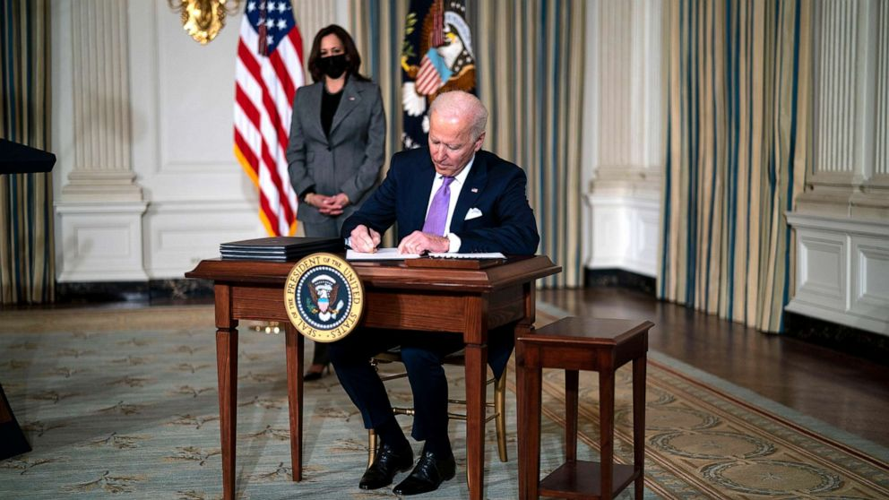
2nd Veto – WOTUS
H.J. Res. 27

Slide 27
SCOTUS Sackett vs. EPA Decided May 25, 2023
Barrett
Gorsuch
Sotomayor
Thomas
Roberts
Jackson
Alito
Kagan
Kavanaugh

Slide 28
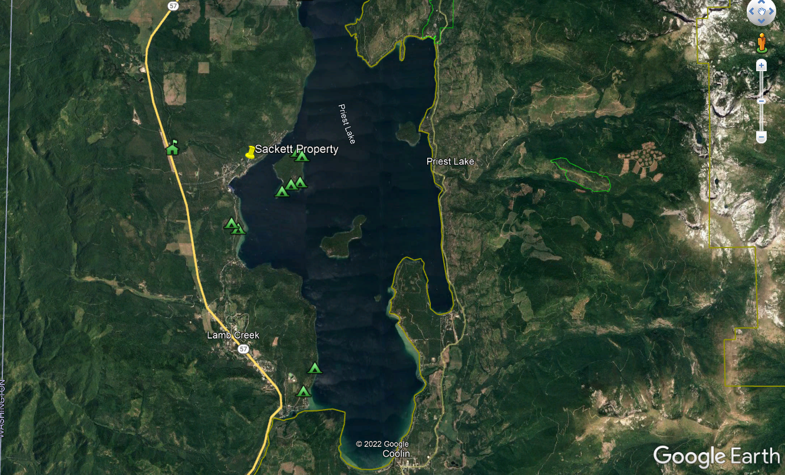
Insert Map of Priest Lake

Slide 29
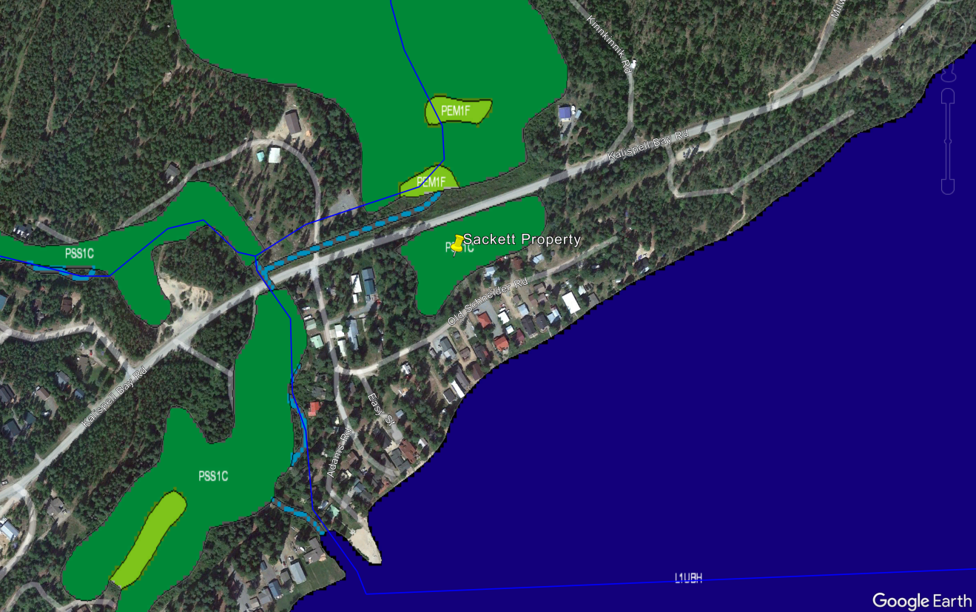

Slide 30
Sackett v. EPA – SCOTUS Ruling
Unanimous (all nine judges agree):
Significant nexus test no longer appropriate.
Sackett’s property does not include adjacent wetlands subject to Clean Water Act jurisdiction.
But four separate opinions as to ‘why?’

Slide 31
Sackett v. EPA – SCOTUS Majority Opinion
The CWA’s use of “waters” in §1362(7) refers only to “geo-graphic[al] features that are described in ordinary parlance as ‘streams, oceans, rivers, and lakes’ ” and to adjacent wetlands that are “indistinguishable” from those bodies of water due to a continuous surface connection. Rapanos v. United States, 547 U. S. 715, 755, 742, 739.

Slide 32
Sackett v. EPA – Two Step Test
To assert jurisdiction over an adjacent wetland under the CWA, a party must establish
“first, that the adjacent [body of water constitutes] . . . ‘water[s] of the United States’ (i.e., a relatively permanent body of water connected to traditional interstate navigable waters); and
second, that the wetland has a continuous surface connection with that water, making it difficult to determine where the ‘water’ ends and the ‘wetland’ begins.”

Slide 33
Alito’s Majority Opinion (Alito, Gorsuch, Thomas, Roberts, Barrett)
What do terms “continuous surface connection” and “relatively permanent” mean?
Alito - “We acknowledge that temporary interruptions in surface connection may sometimes occur because of phenomena like low tides or dry spells.”

Slide 34
Alito’s Majority Opinion (Alito, Gorsuch, Thomas, Roberts, Barrett)
Barriers such as levees, berms or dunes sever jurisdiction.
“Although a barrier separating a wetland from a water of the United States would ordinarily remove that wetland from federal jurisdiction, a landowner cannot carve out wetlands from federal jurisdiction by illegally constructing a barrier on wetlands otherwise covered by the CWA.”

Slide 35
Revised Definition of ‘Waters of the United States’; Conforming (a.k.a. “The 2023 Rule”)
Issued August 29, 2023
Published in Federal Register September 8, 2023

Slide 36
Paragraph (a) – The Five WOTUS
Waters which are:
Used for interstate or foreign commerce, including all waters subject to ebb and flow of the tide (i.e., Traditional Navigable Waters)
The territorial seas
Interstate waters, including interstate wetlands

Slide 37
Paragraph (a) – The Five WOTUS
Impoundments of WOTUS
Other than impoundments of (a)(5) WOTUS
BUT, can still be a WOTUS if it meets the requirements of (1), (3), (4) or (5)

Slide 38
Paragraph (a) – The Five WOTUS
Tributaries of (a)(1) or (2) waters:
(i) That are relatively permanent, standing or continuously flowing, OR
(ii) That either alone or in combination with similarly situated waters in the region, significantly affect the chemical, physical or biological integrity of (a)(1) waters

Slide 39
Paragraph (a) – The Five WOTUS
Wetlands adjacent to:
(a)(1) waters
Relatively permanent, standing or continuously flowing bodies of (a)(2) or (a)(3)(i) waters AND with a continuous surface connection to those waters; OR
(a)(2) or (a)(3) waters when the wetlands either alone or in combination with similarly situated waters in the region, significantly affect the chemical, physical or biological integrity of (a)(1) waters

Slide 40
Paragraph (a) – The Five WOTUS
(5) Intrastate lakes and ponds, streams or wetlands not identified in (a)(1) – (a)(4):
That are relatively permanent, standing or continuously flowing with a continuous surface connection to (a)(1) or (a)(3)(i); OR
That either alone or in combination with similarly situated waters in the region, significantly affect the chemical, physical or biological integrity of (a)(1) waters
Note: Waters may fall into multiple categories

Slide 41
Paragraph (a) includes:
(1) (i) Traditional Navigable Waters, (ii) Territorial Seas, (iii) Interstate Waters
Issued January 18, 2023
Effective March 20, 2023
Currently under injunction in 27 states
Biden EPA 2003 RULE
(4iii)
(5ii)
(2) Impoundments
- of WOTUS
(4iii)
(5ii)?
(4i)
(3ii)
(3) Tributaries
of (1) or (2)
(i) RP
(ii) SN
(4iii)
(4i)
(4iii)
(3i), (3ii) or NJD
(4iii)
(4) Wetlands
(i) Adjacent to (1)
(ii) Adjacent to RP (2) or (3) + CSC
(iii) Adjacent to (2) or (3) + SN
(3ii)
(3i)
(4ii)
(3ii)
(2)
(5ii)
(4ii), (4iii), (5i) or (5ii)
(3ii)
(3ii)
(5) Intrastate Lakes & Ponds, Streams or Wetlands
(i) RP + CSC to (1) or (3)(i)
(ii) SN
(2)
(5ii)
(4i)
(3i)
(3i)
(2)
(5ii)
(4ii)
(3ii)
State Line
(1iii)
RP = Relatively Permanent
SN = Significant Nexus
CSC = Continuous Surface Connection
(1i)
(4i)
*No categorical significant nexus determinations per preamble
(1ii)
Notes:
3 OTHER WATERS: Intrastate lakes, rivers, streams (including intermittent streams), mudflats, sandflats, wetlands, sloughs, prairie potholes, wet meadows, playa lakes, or natural ponds.
Must meet relatively permanent standard AND “significantly affect” standard
CASE SPECIFIC ANALYSIS NEEDED
4 IMPOUNDMENTS: poorly worded, appears that impoundments of intermittent streams won’t be jurisdictional (an (a)(3) water.
*No categorical significant nexus determinations per preamble
BUT, replaced with “significantly affect” language which is defined exactly like the Significant Nexus Analysis, but is described to more broadly to include other options to analyze like
distance from a jurisdictional water,
distance from a TNW, interstate water or territorial sea,
size, density, and number of waters determined to be similarly situated,
hydrologic factors (including subsurface flow), and
climatological variables (temp., rainfall, and snowpack).
SEEKED COMMENT on this list of variables.
Termed to MEET THE SIGNIFICANT NEXUS STANDARD

Slide 42
Paragraph (a) includes:
(1) (i) Traditional Navigable Waters, (ii) Territorial Seas, (iii) Interstate Waters
Issued August 29, 2023
Effective September 8, 2023
Currently under injunction in 27 states
Biden EPA 2003 ‘CONFORMING’ RULE (Post-Sackett)
(2) Impoundments
- of WOTUS
(4ii)?
(4i)
(3) Tributaries
of (1) or (2)
(i) RP
(4ii)?
(4i)
(4ii)?
(4) Wetlands
(i) Adjacent to (1)
(ii) Adjacent to RP (2) or (3) + CSC
(3i) or NJD
(3i)?
(3i)
(4ii)
(4ii)?
(3i)
(3i)
(2)
(3i)?
(4ii)
State Line
(1iii)
RP = Relatively Permanent
SN = Significant Nexus
CSC = Continuous Surface Connection
(1i)
(4i)
*No categorical significant nexus determinations per preamble
(1ii)
Notes:
3 OTHER WATERS: Intrastate lakes, rivers, streams (including intermittent streams), mudflats, sandflats, wetlands, sloughs, prairie potholes, wet meadows, playa lakes, or natural ponds.
Must meet relatively permanent standard AND “significantly affect” standard
CASE SPECIFIC ANALYSIS NEEDED
4 IMPOUNDMENTS: poorly worded, appears that impoundments of intermittent streams won’t be jurisdictional (an (a)(3) water.
*No categorical significant nexus determinations per preamble
BUT, replaced with “significantly affect” language which is defined exactly like the Significant Nexus Analysis, but is described to more broadly to include other options to analyze like
distance from a jurisdictional water,
distance from a TNW, interstate water or territorial sea,
size, density, and number of waters determined to be similarly situated,
hydrologic factors (including subsurface flow), and
climatological variables (temp., rainfall, and snowpack).
SEEKED COMMENT on this list of variables.
Termed to MEET THE SIGNIFICANT NEXUS STANDARD

Slide 43
Paragraph (b) – The Eight Exemptions
Waste Treatment Systems
Prior Converted Cropland
Exclusion ceases upon change of use
Ditches
Wholly in and draining only dry land, AND
Do not carry a relatively permanent flow of water
Artificially irrigated areas
That would revert to dry land if the irrigation ceased

Slide 44
Paragraph (b) – The Eight Exemptions
Artificial lakes or ponds
Created by excavating or diking dry land
Used exclusively for such purposes as
stock watering, irrigation, settling basin or rice growing
Artificial reflecting or swimming pools
Created by excavating or diking dry land primarily for aesthetic reasons
Waterfilled depressions
Incidental to construction activity
Pits excavated in dry land for fill, sand or gravel
Unless abandoned and reverts to a WOTUS
Swales and erosional features
Characterized by low volume, infrequent or short duration flow

Slide 45
Paragraph (c) – The Definitions
Wetlands
Adjacent
High Tide Line
Ordinary High Water Mark (OHWM)
Tidal Waters
Significantly Affect

Slide 46
(2) Adjacent
Means bordering, contiguous, or neighboring. Wetlands separated from other waters of the United States by man-made dikes or barriers, natural river berms, beach dunes, and the like are “adjacent wetlands.”
Means having a continuous surface connection.

Slide 47
Continuous Surface Connection
A continuous surface connection does not require constant hydrologic connection
Wetlands meet the continuous surface connection requirement if they are connected to relatively permanent waters by a discrete feature like a non-jurisdictional ditch, swale, pipe or culvert, or flood gate

Slide 48
Relatively Permanent - Streams
Encompasses surface waters that have flowing or standing water year-round or continuously during certain times of the year (Perennial/Intermittent?)
Rapanos Guidance: “typically year-round or have continuous flow at least seasonally (e.g., typically three months).”
Does not include surface waters with flowing or standing water for only a short duration in direct response to precipitation (Ephemeral)
Requires evaluation of entire reach of a stream
OHWM used to identify tributaries; tributaries include natural, modified or constructed waters

Slide 49
Relatively permanent flow can be artificial
“… relatively permanent waters may include tributaries in which flow is driven more by various water management regimes and practices, such as tributaries with extensive flow alteration (e.g., diversions, bypass channels, water transfers” and effluent-dependent streams.”
– 2023 Rule Preamble

Slide 50
Relatively Permanent - Wetlands
Adjacent wetlands meet the relatively permanent standard if they have a continuous surface connection to a relatively permanent (a)(2) impoundment or a relatively permanent jurisdictional tributary
Flowpath = physical features on the landscape, such as a channel, non-jurisdictional ditch, pipe or swale
Confined and Discrete

Slide 51
Biden WOTUS Rule Status – Three Injunctions
State of TX vs EPA, U.S. Dist. Ct. – South District of Texas (Galveston)
Texas and Idaho
Multiple Plaintiffs vs EPA, U.S. Dist. Ct. – North Dakota District
Alabama, Alaska, Arkansas, Florida, Georgia, Iowa, Indiana, Kansas, Louisiana, Mississippi, Missouri, Montana, Nebraska, New Hampshire, North Dakota, Ohio, Oklahoma, South Carolina, South Dakota, Tennessee, Utah, Virginia, West Virginia, and Wyoming
U.S. Court of Appeals for the Sixth Circuit
Kentucky

Slide 52
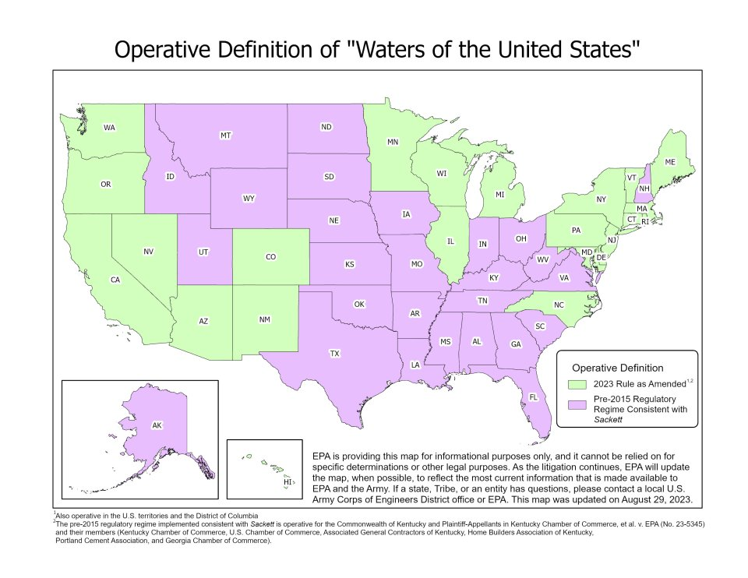

Slide 53
EPA and USACE Webinar Clarifications:
2023 Rule issued without public comment due to good cause under Administrative Procedures Act Section 553(b)(B).
Rule issued with ‘severability’ in mind; i.e. should a court decision invalidate a portion of the 2023 Rule, “the agencies’ intent is to preserve its remaining portions to the fullest extent possible.”
Approved Jurisdictional Determinations (AJDs) again being issued.
In states under injunction, agencies using pre-2015 regulatory regime plus Sackett …

Slide 54
USACE Galveston & Fort Worth District Status
Using Rapanos Guidance (12/2008) informed by Sackett v. EPA
Wetlands – confined/discrete continuous surface connection
Streams – “wetter” intermittent & perennial
Issuing AJDs, but must coordinate with EPA Region 6/HQ
Fort Worth favoring “Delineation Concurrences”
Informal request from applicant
Maps aquatic features potentially requiring USACE permit to impact
No mention of “WOTUS” or “jurisdiction”
Using regionally-specific tools

Slide 55
Regionally-Specific Tools
USGS National Map Viewer, Topographic Maps, NHD, NWI, SSURGO, LiDAR
USGS Stream Stats, HEC-RAS, HEC-HMS, NHDPlus, Mod Flow, Flow Simulation Model VS2DI
EPA’s Watershed Assessment, Tracking, and Environmental Results System (WATERS)
EPA’s EnviroAtlas Interactive Map
EPA’s Enforcement & Compliance History Online (ECHO) Map Services
EPA’s Clean Water Act Approved Jurisdictional Determinations website
Corps’ Jurisdictional Determinations and Permit Decisions website
Probability of Streamflow Permanence (PROSPER)
Streamflow Duration Assessment Methods (SDAMs)
Streamflow Methodology for Identification of Intermittent and Perennial Streams (NC Division of Water Quality)
Antecedent Precipitation Tool (APT)
Soil & Water Assessment Tool (SWAT)
DRAINMOD for Watersheds (DRAINWAT)

Slide 56
So What’s Next?

Slide 57
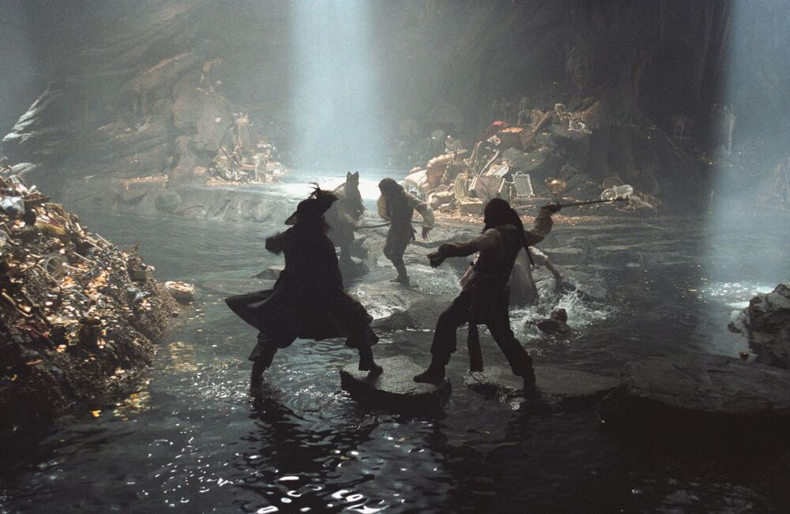
“So what now, Jack Sparrow? Are we to be two immortals locked in an epic battle until Judgment Day and trumpets sound?”
POTUS
SCOTUS
WOTUS

Slide 58
Unless …
“Unless Congress amends the Clean Water Act to spell out a detailed definition of Waters of the US based on the proven science of hydrologic connectivity the Clean Water Act’s goal of restoring and maintaining the chemical, physical and biological integrity of the nation’s waters will literally be impossible to achieve.”
- Betsy Southerland, former EPA administrator and current member of the Environmental Protection Network, an organization of former EPA staffers whose mission is to generate bipartisan support for the environment.

Slide 59
WOTUS Questions?

