Slide 1
Harris County Flood Control District
LOMR Review Program
Todd Ward, P.E., CFM
Department Manager
Risk Mitigation Department
Harris County Flood Control District

Slide 2
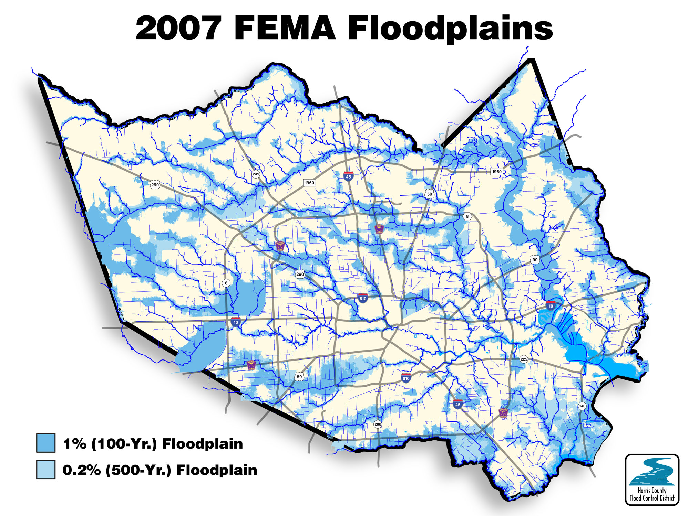
Notes:
As might be expected, Harris County’s biggest natural disaster problem is flooding.
About 25% of Harris County is within a floodplain. 1/5 of that is “supposed to flood” as lakes, reservoirs, and within banks or HCFCD ROW.

Slide 3
TSARP
Study of 22 Watersheds
1,700 square miles
1,200 stream miles
10,000 surveyed cross-sections
Effective Maps June, 2007
$32,000,000 Investment (50/50 cost share with FEMA)
Notes:
This study was a massive undertaking, and we wanted to take responsibility for making sure the quality of these models were maintained.

Slide 4
Why Model Management?
Protect our investment (TSARP)
Ensure flood models and maps represent true, on-the-ground conditions
Support resiliency efforts by providing accurate flood hazard information to FEMA and local communities

Slide 5
Our Agreement with FEMA
Mapping Activity Statement (MAS) 14
Standards
Web Based Model distribution (M3)
MOA with FPA for Standards
Process to have up-to-date effective model
HCFCD Custodian of models
Notes:
MAS = MOA with FEMA

Slide 6
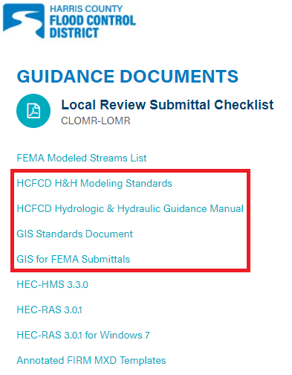
Standards
Purpose
Maintain the integrity of the models and supporting data
Ensure model modifications are made in a consistent manor so others can easily understand changes
Notes:
Includes naming conventions, model version requirements, requirement of no impact due to projects, and more.

Slide 7
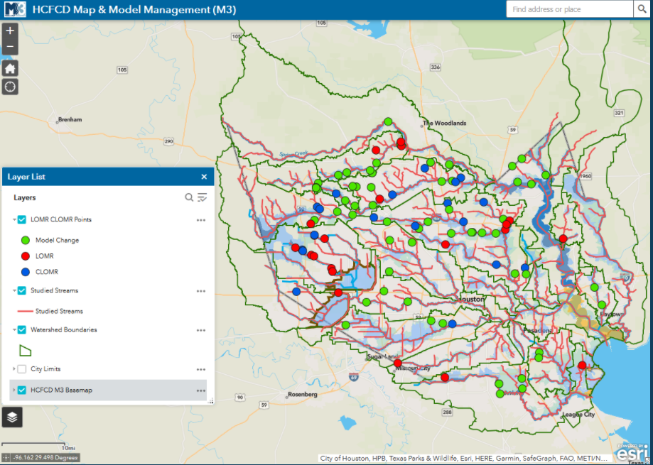
M3 Model Library
Notes:
Model library provides free access to the effective models, and allows you to log your project so that you will be notified of changes to the effective models associated with your project, and to inform you of others working in on those models who might end up revising your project’s models.

Slide 8
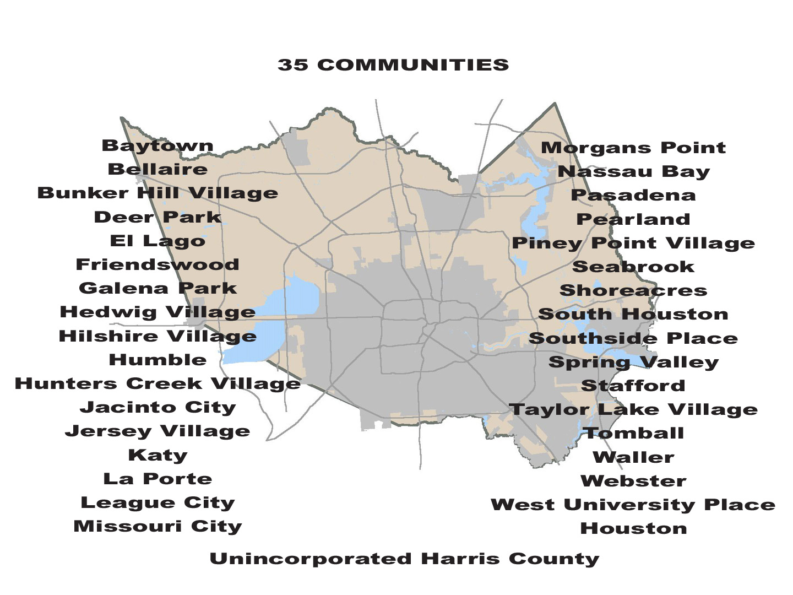
Notes:
There are 35 NFIP communities in Harris County. 31 of those communities have adopted the Harris County FIRM maps.

Slide 9
Memorandum of Understanding
HCFCD Responsibilities:
Provide current/accurate models from web
Provide technical resource
Provide training
Cursory review
Local Community Responsibilities:
Obtain models from HCFCD
Follow Standards
Provide HCFCD a copy of map revision submittal for review prior to signing MT-2
Notes:
MAS = MOA with FEMA

Slide 10
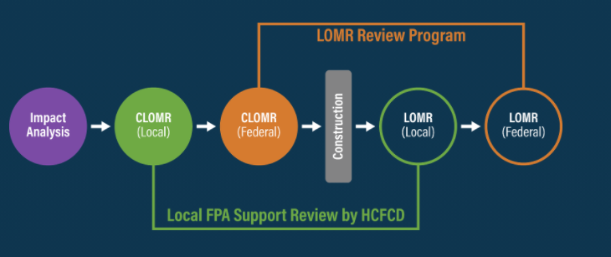
The Process
As we move through the development process there are various submissions that may be required. These submissions are often based on different review criteria:
Notes:
READ SLIDE

Slide 11
Local Review
Why is this step important?
To provide technical support to Floodplain Administrators (FPA’s)
To maintain current models and GIS shapefiles consistent with applicable standards
Make sure all information is included for LOMR Delegation review
Protect the community Investment
Notes:
Talking Point #1
Per MAS 14, Local Review is required for us to be custodians of the model. We must adhere to that agreement by making sure the local standards are met during this review process.
~ For example, Harris County Floodplain Administrator will not sign the MT-2 Form until this review is complete. On a case by case basis, we would provide this support to the City of Houston and other FPA’s if requested.
Talking Point #2
~Protecting the community- $32 million investment of the TSARP Project

Slide 12
Upcoming Challenges
Moving to 1D/2D Coupled Hydraulic Models

Slide 13
Study Drivers
National Oceanic and Atmospheric Administration (NOAA) - Atlas 14 Precipitation – Frequency Update
Hurricane Harvey & other recent (since 2015) severe floods
Better more accurate technology and methodologies that allow for consideration of additional flood hazards

Slide 14
NOAA Atlas 1% AEP 24 Hour Rainfall Totals
Notes:
The NOAA Atlas study significantly increased the rainfall totals for Harris County.

Slide 15
Project Description
County-wide restudy of all floodplains in Harris County
New streams will be added as funding, loss history, and updated modeling techniques allow.
To the extent feasible, identify ALL flood risks in Harris County
Riverine / Traditional Floodplains
Overland / 2D Rain-on-Grid
New Mapping Products – Beyond the “100 Year” Storm

Slide 16
Upcoming Challenges
Possible increase in case load
Fewer LOMR-Fs may be allowed and more LOMRs required
Changes to model review
New standards/requirements will be developed for 1D/2D model reviews
Will need to train reviewers and the engineering community on 1D/2D model review
The hydraulic modeling will be more complex, and the reviews could take more work
Need to overhaul our M3 system

Slide 17
QUESTIONS?

Slide 18
Todd Ward, P.E., CFM
Risk Mitigation Department Manager
Harris County Flood Control District
13105 Northwest Freeway, Ste. 600 | Houston, Texas 77040
346-286-4000 (main) | 346-286-4858 (direct)
Todd.Ward@hcfcd.hctx.net | www.hcfcd.org

