Slide 1
Produced Wastewater Permitting
November 2, 2023

Slide 2
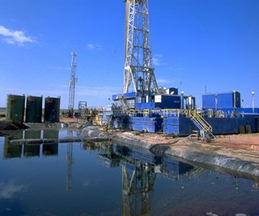
Produced Wastewater Regulatory Authority
Texas Legislation
Regulatory Authority
Railroad Commission of Texas (RRC)
Environmental Protection Agency (EPA)
Texas Commission on Environmental Quality (TCEQ)
Notes:
House Bill 2771, 86th Texas Legislature (2019)
Required TCEQ to submit a request to the U.S. EPA for regulatory authority for oil and gas discharges.
Required a transfer of state regulatory authority from the Railroad Commission of Texas (RRC) to the TCEQ.
Administrative Implementation
Conducted rulemaking and revised memos of understand and agreement
Adopted federal oil and gas Effluent Limitations Guidelines in 40 CFR Parts 435 and 437 into Texas Administrative Code.
Revised the Memorandum of Understanding with the Texas Railroad Commission regarding oil and gas jurisdiction.
Revised the Memorandum of Agreement with the EPA for the National Pollutant Discharge Elimination System (NPDES) Program.
TCEQ requested authority from the United States Environmental Protection Agency (EPA) to issue federal permits for produced water, hydrostatic test water, and gas plant effluent discharges resulting from certain oil and gas activities into water in the state as required by House Bill 2771, 86th Legislature 2019. EPA approved the request effective January 15, 2021. The authority for these discharges was transferred from the Railroad Commission (RRC) of Texas to TCEQ.

Slide 3
TPDES MOA Addendum January 15, 2021
Transfer of Oil and Gas Permitting Authority
New and Pending Individual Applications
Effective (Active) Individual Permits
Effective (Active) General Permits
Transfer of Compliance Monitoring and Enforcement Authority
New and Pending Individual Applications
Effective (Active) Individual Permits
Effective (Active) General Permits
Permits with Pending Enforcement Actions
Transfer of Information and Records
Notification to Permittees
Notes:
TCEQ requested authority from the United States Environmental Protection Agency (EPA) to issue federal permits for produced water, hydrostatic test water, and gas plant effluent discharges resulting from certain oil and gas activities into water in the state as required by House Bill 2771, 86th Legislature 2019. EPA approved the request effective January 15, 2021. The authority for these discharges was transferred from the Railroad Commission (RRC) of Texas to TCEQ.
Memo is on the web (TCEQ and EPA). URL is https://www.tceq.texas.gov/downloads/permitting/wastewater/municipal/tpdes-moa-addendum-final-signed.pdf - Google “TPDES MOA ADDENDUM”

Slide 4
Produced Wastewater
The fluid brought up from the hydrocarbon-bearing strata during the extraction of oil and gas, and includes, where present, formation water, injection water, and any chemicals added downhole or during the oil/water separation process.
[40 CFR 435.33 (v)]
Management Options
Reuse within the oil field
Disposal by underground injection
Treatment and disposal by discharge to surface waters
Notes:
This presentation will focus on the permitting options associated with the discharge to surface waters

Slide 5
Texas Pollutant Discharge Elimination System (TPDES)
The Texas Commission on Environmental Quality (TCEQ) is federally delegated by the U.S. Environmental Protection Agency to implement the TPDES program to control discharges of pollutants to surface waters of the Unites States.
TPDES permits are developed under Chapter 26 of the Texas Water Code, which authorizes TCEQ to set requirements in a permit before an entity discharges wastewater into the surface waters of the State.
TCEQ prepares TPDES permits that comply with state and federal water quality rules and regulations:
individual authorizations
general permits
Notes:
TCEQ has delegated authority to regulate discharges into surface waters as provided in the Clean Water Act.

Slide 6
TPDES permits
Protect the quality of water bodies by:
Assessing the wastestreams and receiving waters
Controlling pollutants discharged from point sources
Effluent limitations
Monitoring and Reporting (M/R) requirements

Slide 7
TCEQ Types of Permits
One Individual Permit and Five General Permit Options
Wastewater Permit Types
1. Texas Pollutant Discharge Elimination System (TPDES) Individual Permits
2. TPDES Oil and Gas General Permit TXG310000 – Pending
3. Outer Continental Shelf General Permit WQG280000 – Pending
4. Hydrostatic Testing General Permit TXG670000
Stormwater Permit Types
5. Construction General Permit TXR150000
6. Multi-Sector General Permit TXR050000 – Amendment Pending
Notes:
TCEQ has four Wastewater permits and two stormwater general permits that may be used for the disposal or management of oil and gas activity wastewaters.
Individual permits are written and issued to reflect site-specific conditions of a single discharger and are unique. Individual permits require a detailed permit application. The permitting process for an individual permit is about one year from receipt of the application and includes administrative and technical review, preparation of a draft permit, and two public notices and a public comment period. In some cases, a public meeting for an individual application may occur along with review by EPA Region 6.
A general permit is typically statewide and is written to cover multiple dischargers with similar operations and types of discharge based on the activity. The application process (known as a Notice of Intent) for a general permit is simplified because the applicable standard requirements are already provided in the general permit.
TCEQ has worked to develop new general permits in the case of the TXG31 and WQG28. Other permit types have been amended or will be amended to consider oil and gas activities.

Slide 8
Overview
Three wastewater general permits
TXG310000 - East
WQG280000 - East
TXG670000 - Statewide
Two stormwater general permits
Statewide
Individual wastewater permit
Statewide
Notes:
I will be discussing each of these six permits in the order listed on the screen.
I will provide a description of the types of oil and gas operations covered under each of the permits and their allowable and prohibited discharges.
A status of the TCEQ permit and any notable differences to Railroad Commission or federal permits will also be provided.
NOTE: Federal regulations limit discharges of produced water from oil and gas extraction operations based on location. Federal regulations also prohibit moving effluent generated in one area to another area for discharge under less stringent requirements.

Slide 9
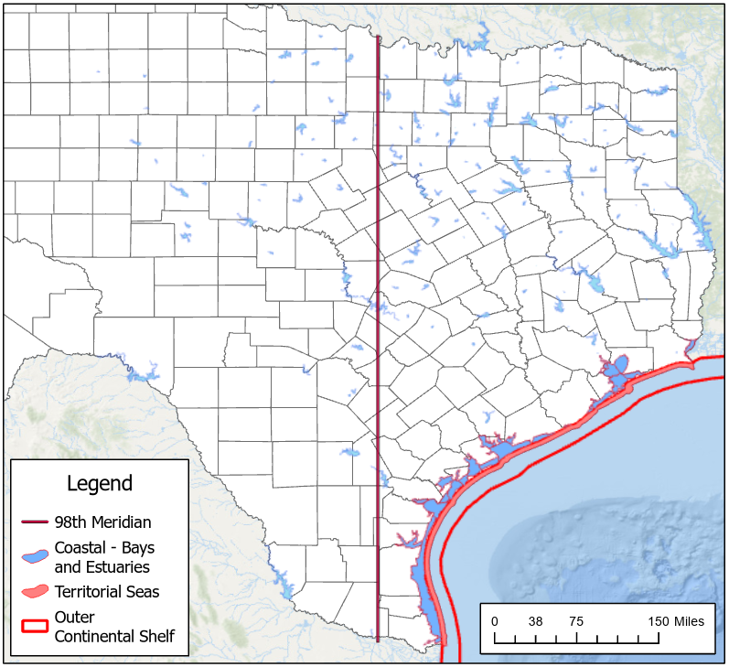
TXG310000
New general permit to authorize new and existing
onshore stripper well facilities
coastal facilities
territorial seas facilities
For activities EAST of the 98th Meridian
Notes:
All waste streams authorized for discharge under the draft TPDES general permit are subject to numeric effluent limitations (or no discharge of the identified pollutant based on visual observation) for varying pollutants with associated established monitoring and reporting requirements. The draft TPDES general permit also establishes prohibitions on discharges of various waste streams based on the geographical location of the facility. These effluent limitations and prohibitions on discharges are primarily based on EPA’s two existing NPDES oil and gas extraction activities general permits and conditions in EPA’s effluent limitation guidelines established at 40 Code of Federal Regulations (CFR) Part 435. Additional effluent limitations in the TPDES discharge general permit based on TCEQ regulations and conditions established in the Texas Surface Water Quality Standards.
STRIPPER WELL FACILITY - An oil and gas extraction operation located on land (not in or on water) east of the 98th meridian which only includes wells that produce 10 barrels per calendar day or less of crude oil and that are operating both at the maximum feasible rate of production and in accordance with recognized conservation practices.

Slide 10
Onshore Stripper Well Facilities TXG310000
Authorize discharge to surface waters
produced wastewater
well treatment (not hydraulic fracturing fluids)
workover fluids
Prohibition of discharge to surface waters
drilling fluids
drill cuttings
produced sand
dewatering effluent
formation test fluids
well completion fluids
hydrate control fluids
domestic waste
sanitary waste
contaminated miscellaneous discharges and uncontaminated miscellaneous discharges
contaminated stormwater
Notes:
STRIPPER WELL FACILITY - An oil and gas extraction operation located on land (not in or on water) east of the 98th meridian which only includes wells that produce 10 barrels per calendar day or less of crude oil and that are operating both at the maximum feasible rate of production and in accordance with recognized conservation practices.

Slide 11
Coastal Facilities TXG310000
Authorize discharge to surface waters
deck drainage
domestic waste
sanitary waste (M10 and M9IM)
uncontaminated miscellaneous discharges
contaminated miscellaneous discharges
Prohibition of discharge to surface waters
drilling fluids
drill cuttings
produced wastewater
produced sand
dewatering effluent
formation test fluids
well treatment, completion, and workover fluids
hydrate control fluids
contaminated stormwater from inland facilities (located on land and not located in a bay, estuary, or wide tidal river where such discharges are considered deck drainage)
Notes:
COASTAL FACILITY - Any oil and gas extraction operation located in or on a water in the State of Texas landward of the inner boundary of the territorial seas; or located landward of the inner boundary of the territorial seas and bounded on the inland side by latitude and longitude coordinates established in 40 CFR Section 435.40(b).

Slide 12
Territorial Seas Facilities TXG310000
Authorize discharge to surface waters
produced wastewater
hydrate control fluids
well treatment, completion, and workover fluids
deck drainage
domestic waste
sanitary waste (M10 and M9IM)
uncontaminated miscellaneous discharges
contaminated miscellaneous discharges
Prohibition of discharge to surface waters
all drilling fluids
all associated drill cuttings
produced sand
dewatering effluent
formation test fluids
Notes:
TERRITORIAL SEA FACILITY - An oil and gas extraction operation located in waters that are seaward of the inner boundary of the territorial seas and extending seaward a distance of three statute miles from the coastline. Territorial seas are defined in Section 502(8) of the Clean Water Act(CWA).

Slide 13
How is TXG310000 Different
TXG310000 will replace EPA General Permits
TXG260000 and TXG330000
TXG310000 will replace individual RRC permits
Application processes are simplified
Each discharging facility submits an individual application (NOI)
Cooling Water intake structure (CWIS) requirements apply
Discharge of domestic waste is subject to effluent limitations
Revised whole effluent toxicity (WET) limitations and monitoring
Notes:
Fees $800 NOI fee and $100 annual WQ fee.
Number of current/expected authorizations:
TCEQ received and consolidated files and data transmitted from EPA and RRC following transfer of permitting authority. Based on TCEQ’s reconciliation of these files/data, 33 entities are currently authorized to discharge to surface waters in the state. They are expected to seek authorization under the new TPDES general permit.
New authorizations may increase moderately as the new TPDES general permit requires each discharging facility to submit an NOI versus allowing all facilities located within a lease or state tract to submit one NOI, as discussed below.

Slide 14
Effluent & Monitoring Requirements TXG310000
Effluent limitations for discharges to Territorial Seas (Segment 2501)
Additional WQBELS for produced water discharge to territorial seas
Total Copper, Total Manganese, and Total Zinc
Monitoring and Reporting (M/R) Requirements
New Total Mercury M/R requirement for produced water
Territorial Seas Facility produced water effluent flow limitation
0.126 million gallons per day (3000 barrels/day)
Notes:
G..Additional water quality-based effluent limitations for the discharge of produced wastewater to territorial seas (based on TCEQ-developed CORMIX dilution modeling) for total copper, total manganese, and total zinc. A three-year compliance schedule for existing produced wastewater discharged via either EPA’s existing TXG260000 or a RRC individual authorization is provided. Additionally, a new monitoring and reporting requirement is established for total mercury for discharges of produced wastewater. For produced wastewater discharges from territorial seas facilities, an effluent flow limitation of 0.126 million gallons per day (3000 barrels/day), restrictions on depth to sea floor, and restrictions on pipe diameter are based on CORMIX dilution modeling conducted by TCEQ. Furthermore, effluent monitoring requirements for total dissolved solids (TDS) and temperature to gather data to confirm assumptions TCEQ used in its CORMIX dilution modeling for produced wastewater discharges to the territorial seas.
H.. For produced wastewater discharges to territorial seas, water quality-based effluent limitations on carbonaceous biochemical oxygen demand (5-day) and ammonia-nitrogen based on TCEQ’s dissolved oxygen modeling assessment, to ensure dissolved oxygen standards in the Gulf of Mexico are achieved.

Slide 15
TXG310000 Status
TXG310000 will replace EPA General Permits
TXG260000 and TXG330000
TXG310000 will replace individual RRC permits
Continue following EPA’s permits until TXG310000 is issued
September 14, 2022
EPA submitted recommendations with no interim objection
May 12, 2023 – June 12, 2023
Public comment period
November 29, 2023
TCEQ Commission Agenda Date to consider TXG310000
Notes:
Fees $800 NOI fee and $100 annual WQ fee.
Number of current/expected authorizations:
TCEQ received and consolidated files and data transmitted from EPA and RRC following transfer of permitting authority. Based on TCEQ’s reconciliation of these files/data, 33 entities are currently authorized to discharge to surface waters in the state. They are expected to seek authorization under the new TPDES general permit.
New authorizations may increase moderately as the new TPDES general permit requires each discharging facility to submit an NOI versus allowing all facilities located within a lease or state tract to submit one NOI, as discussed below.

Slide 16
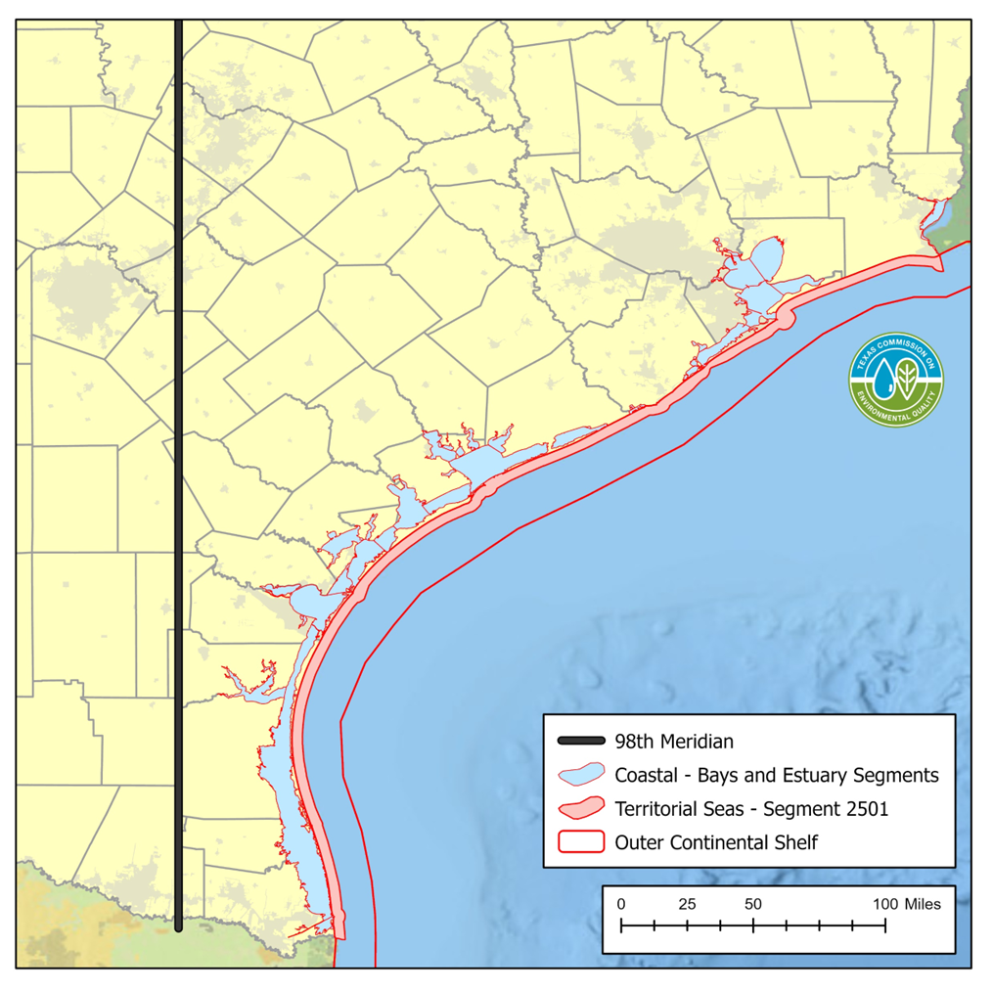
Outer Continental Shelf
Between 3 and 10.2 miles of the Texas coastline
Beyond 10.2 miles TCEQ has no regulatory authority, and permitting is only administered by EPA.
WQG280000
Notes:
The second wastewater general permit TCEQ is developing is not under the TPDES program, and separate EPA authorization is required under NPDES general permit GMG290000.
OUTER CONTINENTAL SHELF FACILITY
An oil and gas extraction operation located in waters that are seaward of the inner boundary of the territorial seas and extending seaward a distance between three statute miles from the coastline to 10.2 statute miles from the coastline. Territorial seas are defined in Section 502(8) of the Clean Water Act(CWA).

Slide 17
Outer Continental Shelf Facilities WQG280000
Authorize discharge to surface waters in Gulf of Mexico
produced wastewater
hydrate control fluids
well treatment, completion, and workover fluids
deck drainage
domestic waste
sanitary waste (M10 and M9IM)
contaminated miscellaneous discharges and uncontaminated miscellaneous discharges
water-based drilling fluids and associated drill cuttings
drill cuttings associated with non-aqueous drilling fluids
Prohibition of discharge to surface waters
non-aqueous drilling fluids
produced sand
dewatering effluent
formation test fluids

Slide 18
WQ280000
New state general permit to authorize discharges to Gulf of Mexico
Outer Continental Shelf
Between 3 miles and 10.2 miles (3 leagues) from shore
Beyond Segment 2501
WQ280000 does not replace EPA General Permit
GMG290000
EPA does not delegate NPDES authorization past 3-mile boundary
Apply for state WQ280000 permit and maintain federal permit
November 29, 2023
TCEQ Commission Agenda Date to consider WQ280000

Slide 19
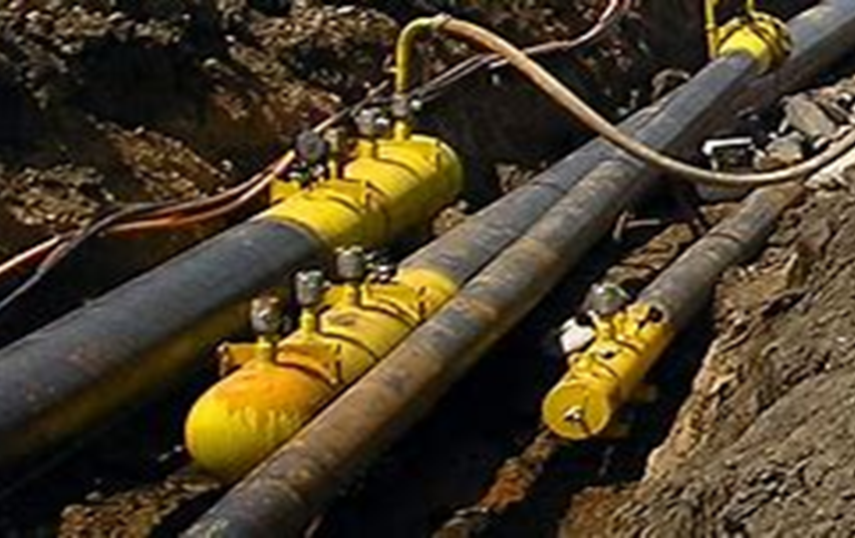
Hydrostatic Test Discharges
A method of determining the hydraulic and structural integrity of a vessel by either introducing water into the vessel or submerging the empty vessel in water.
Notes:
The third general permit TXG670000 is for hydrostatic discharges.

Slide 20
Hydrostatic Test Discharges TXG670000
Available statewide general permit for discharges of hydrostatic test water
From crude oil and natural gas operations for
Exploration
Development
Production
TXG670000 issued October 2020
Expires April 5, 2025
100 operations active TXG670000 permits (October 2023)
Prior to transfer of permitting authority to TCEQ, hydrostatic test discharges required individual permit authorizations from both EPA and RRC.
Notes:
Hydrostatic Testing General Permit TXG670000 was amended in October 2020 to expand the applicability for hydrostatic testing for oil and gas activities. It authorizes the discharge of water resulting from a hydrostatic test of a vessel and/or pipeline into or adjacent to water in the state from new/existing vessels and/or pipelines that contain or previously contained: raw or potable water, elemental gases only, petroleum products, waste related to petroleum products, crude oil, raw natural gas, and natural gas products (e.g LNG/NGL).
Of the 100 authorized discharges most are located on the coast near ports. Harris County has 28, Brazoria =12, Nueces = 12 and Jefferson County has 10

Slide 21
Stormwater General Permits
Statewide TPDES general permits for stormwater discharges from construction activities and certain industrial activities.
Construction General Permit (TXR150000, CGP)
Amended to expand applicability for non-exempt oil and gas construction activities
Multi-Sector General Permit (TXR050000, MSGP)
Will be amended (2026) to allow coverage of non-exempt oil and gas exploration, production, processing, or treatment operations or transmission facilities
Obtain coverage under the federal EPA MSGP
Notes:
Construction General Permit (TXR150000, CGP) was amended on January 28, 2022, to expand the applicability for non-exempt oil and gas construction activities. This general permit was renewed on March 5, 2023, with continued coverage for stormwater discharges from non-exempt oil and gas construction activities. This general permit authorizes the discharge of stormwater from construction and construction support activities.
Multi-Sector General Permit (TXR050000, MSGP) authorizes the discharge of stormwater from certain industrial activities. The existing general permit, issued August 14, 2021, excludes stormwater discharges from industrial activities associated with the exploration, development, or production of oil or gas or geothermal resources, including transportation of crude oil or natural gas by pipeline. Thus, at this time, new and existing oil and gas facilities must obtain or maintain stormwater coverage under the federal EPA MSGP until TCEQ’s MSGP is amended. The TCEQ MSGP will be amended to allow coverage for discharges of stormwater from industrial activities associated with non-exempt oil and gas exploration, production, processing, or treatment operations or transmission facilities. The amendment is expected to be completed prior to February 28, 2026, the expiration date of EPA’s 2021 MSGP.

Slide 22
Individual wastewater permits
When is an individual industrial permit required?
Required for facilities that do not meet requirements of a general permit
What oil and gas activity may require an individual permit?
Oil and gas extraction
Natural gas processing plants
Stripper wells
Updated Industrial TPDES permit application
Updated Administrative Report (TCEQ-20893)
Updated Technical Report (TCEQ-10055)
Worksheet 12.0 oil and gas exploration, development and production
Notes:
Although the regulation of oil and gas operations is not new, permitting under Texas’s TPDES program is new.
Industry indicated that unless the produced water has total dissolved solids concentrations generally of less than a few thousand milligrams per liter, treatment using membranes (e.g., reverse osmosis) or distillation would be necessary to generate water that is suitable for agricultural uses or for discharge to surface waters. The cost of such treatment is not currently competitive where other wastewater management options are available.

Slide 23
Implementation Procedures (IPs)
Procedures to Implement the Texas Surface Water Quality Standards (Regulatory Guidance, RG-194)
The Texas Surface Water Quality Standards are implemented when issuing permits for wastewater discharges to surface waters of the state.
Surface water quality assessment and impairment status are considered, as provided in the Texas Integrated Report.
Notes:
Individual TPDES permit applications received for produced water (wastewater) discharges west of the 98th meridian will be analyzed on a case-by-case basis based on the requested permitted flow and unique characteristics of the receiving water body, resulting in the inclusion of site-specific limitations and requirements. The TPDES industrial wastewater permit application and associated instructions establish conditions to collect data from the applicant to ensure water quality standards are protected. Effluent limitations are also developed to ensure EPA’s national effluent limitation guidelines stated in 40 CFR Part 435 are met, as well as TCEQ’s established Texas Surface Water Quality Standards stated in 30 TAC Chapter 307. Currently, there are no federal effluent guidelines for several of the constituents listed. Effluent guidelines are national wastewater discharge standards that are developed by EPA. Development of effluent guidelines is conducted at the federal level, with state participation, and includes an approved laboratory analytical method. Without effluent guidelines, approved methods, or accredited laboratories for some of these constituents, TCEQ is unable to establish effluent limitations in TPDES permits for these types of constituents. Applicable effluent limitations for these types of constituents will be incorporated in individual TPDES permits as the effluent limitations guidelines become available.

Slide 24
Effluent Limitations
Water quality-based effluent limitations are based on the volume of produced water discharge and unique characteristics of the receiving stream (classified segment).
Technology-based effluent limitations in 40 CFR Part 435, Subpart E daily maximum oil and grease concentration of 35 mg/L

Slide 25
West of the 98th Meridian
An individual permit is needed west of the 98th Meridian for many oil and gas activities.
Produced wastewater discharge prohibited except if put to beneficial use for agriculture or wildlife purposes.
Notes:
Individual Permits are required for oil and gas extraction operations located west of the 98th meridian. Produced water discharge is only allowed to be discharged if it’s put to beneficial use for agriculture or wildlife purposes. Additionally, all discharges from natural gas processing plants (such as liquified natural gas or natural gas liquids processing facilities) require an individual TPDES permit. There are no restrictions related to the location of natural gas processing plants.
NOTE: Federal regulations limit discharges of produced water from oil and gas extraction operations based on location. Federal regulations also prohibit moving effluent generated in one area to another area for discharge under less stringent requirements.
TCEQ has issued some individual permits to renew and/or amend existing permits that were previously issued by EPA and/or RRC. Most of these are located east of the 98th Meridian. Two discharge permits are located west.

Slide 26
Produced Wastewater West vs East
West of 98th Meridian | East of 98th Meridian
Discharge prohibited except if put to beneficial use for agriculture or wildlife purposes. | Discharge allowed in individual permit.
 | Discharge prohibited from coastal facilities.
 | Discharge allowed from stripper wells facilities.
 | Discharge allowed from territorial seas facilities.
 | Discharge allowed from outer continental shelf facilities.
Federal regulations limit discharges of produced water from oil and gas extraction operations based on location. Federal regulations also prohibit moving effluent generated in one area to another area for discharge under less stringent requirements.
Notes:
Yes, TCEQ has received individual permit applications for renewal and/or amendment of existing permits that were previously issued by EPA and/or RRC. TCEQ has not received any individual permit applications for new permits since jurisdiction transferred from EPA and RRC to TCEQ. Two located west of the 98th Meridian are in south Texas and meet the requirements of 40 CFR Part 435 to ensure that their discharge benefits downstream agriculture or wildlife uses.
The most common SIC codes are 1311, 1321, 4922, and 4925. The query may be refined by including location information such as county.

Slide 27
Status of Permits - October 2023
Transferred Authorizations
RRC + Combined EPA/RRC + EPA ≈ 140
Includes cancelled and expired permits
Pending TCEQ Authorizations for Existing Facilities
12
Issued TCEQ Authorizations for Existing Facilities
11
TCEQ Applications or Authorizations for New Facilities
0 (No applications received as of October 31, 2023)
Notes:
Over 140 authorizations were transferred to TCEQ. These include Railroad Commission permits, combined Railroad Commission and EPA permits, and permits issued by EPA. Many of these transfers included cancelled or expired permits that may represent facilities that are no longer active.

Slide 28
EPA review
SIC | Facility Type | Pending | Issued
1311 | Oil and Gas Exploration | 5 | 0
1321 | Natural Gas Liquids | 4 | 10
1381 | Drilling Oil and Gas Wells | 0 | 0
1382 | Oil and Gas Exploration Services | 0 | 0
1389 | Oil and Gas Field Services, Not Elsewhere Classified | 0 | 0
4922 | Transmission and Storage of Natural Gas | 1 | 0
4925 | Manufacture and Distribution of Gas | 1 | 1
5171 | Wholesale of Petroleum Products | 1 | 0
 | TOTALS | 12 | 11
“EPA will review the first two TPDES draft permits for each of the following SIC Codes that are developed on or after the date of program authorization: 1311, 1321, 1381, 1382, 1389, 4922, and 4925.”
Subsequent applications may be subject to EPA review.
Notes:
Most of the issued permits are for natural gas facilities.
Of the 23 applications 20 of these are east of the 98th meridian and typically in the coastal zone.
There are two applications that will discharge produced water west of the 98th.

Slide 29
Robert Sadlier Robert.Sadlier@tceq.texas.gov
wqap@tceq.texas.gov
www.tceq.texas.gov/permitting/wastewater
512-239-4671

