Slide 1
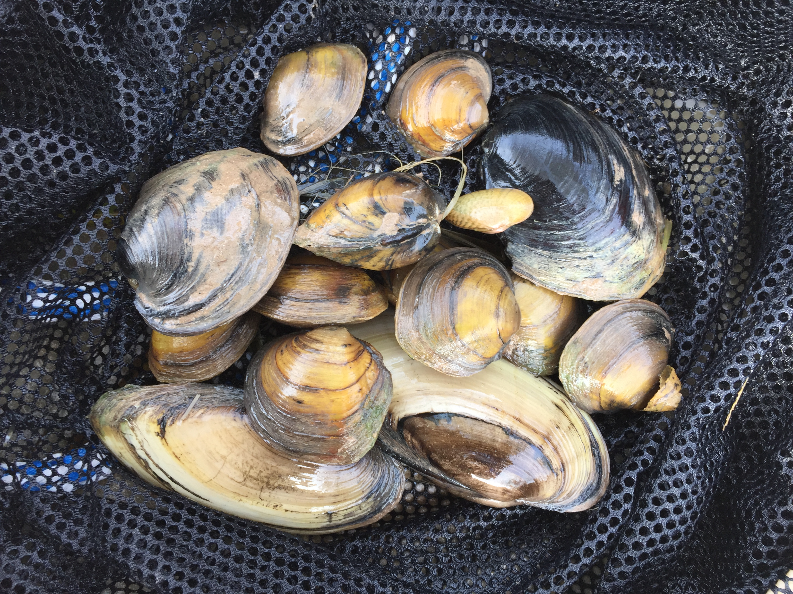
LCRA and LCRA Transmission Services Corporation
Candidate Conservation Agreement with Assurances
Notes:
Role in aquatic ecosystem
Different than ZMs

Slide 2
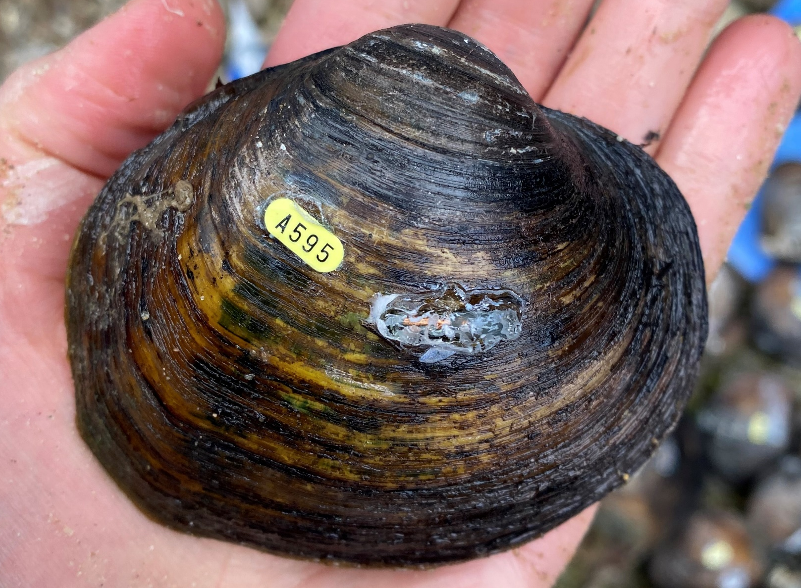
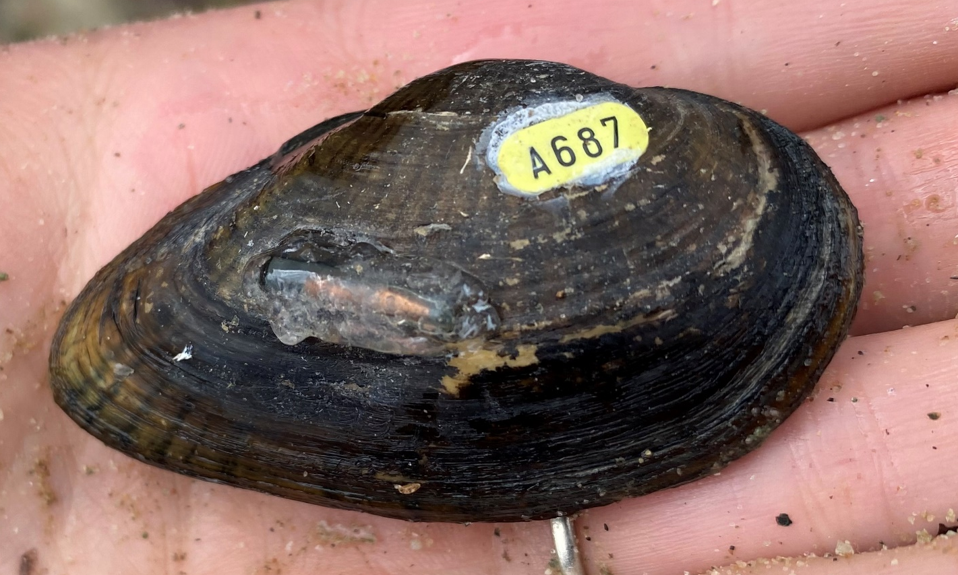
Colorado River Mussels
(just the ESA-proposed ones…we have lots more)
G. Pandolfi – FWS
G. Pandolfi – FWS
L. Benton – LCRA
Texas pimpleback (Cyclonaias petrina)
Proposed as Endangered
Texas fatmucket (Lampsilis bracteata)
Proposed as Endangered
Balcones spike (Fusconaia iheringi)
Proposed as Endangered
L. Benton – LCRA
Texas fawnsfoot (Truncilla macrodon)
Proposed as Threatened
Notes:
Six species across four basins, more than 1,900 miles of proposed critical habitat
In Colorado River basin – four species, two endemic
Once listed, “take” is prohibited**
Formal protection expected…any day now
This slide shows the four federally proposed species we have in our basin. The two on the top middle and left, Texas pimpleback and Texas fatmucket, are found only in the Texas Colorado River basin and no where else in the world.
The next slide will give you a sense of scale in our basin.
[NOTE: if anyone asks about the tags/numbers on the shells, the response can be: “these mussels are a part of a study in the lower river near Altair and those are the tracking devices.”]

Slide 3
Candidate Conservation Agreement with Assurances (CCAA)
Formal agreement between FWS and one or more parties before a species is listed
Must provide a “net conservation benefit” to the species through voluntary conservation actions
If species are listed, incidental take permit is issued for the Covered Activities in the CCAA

Slide 4
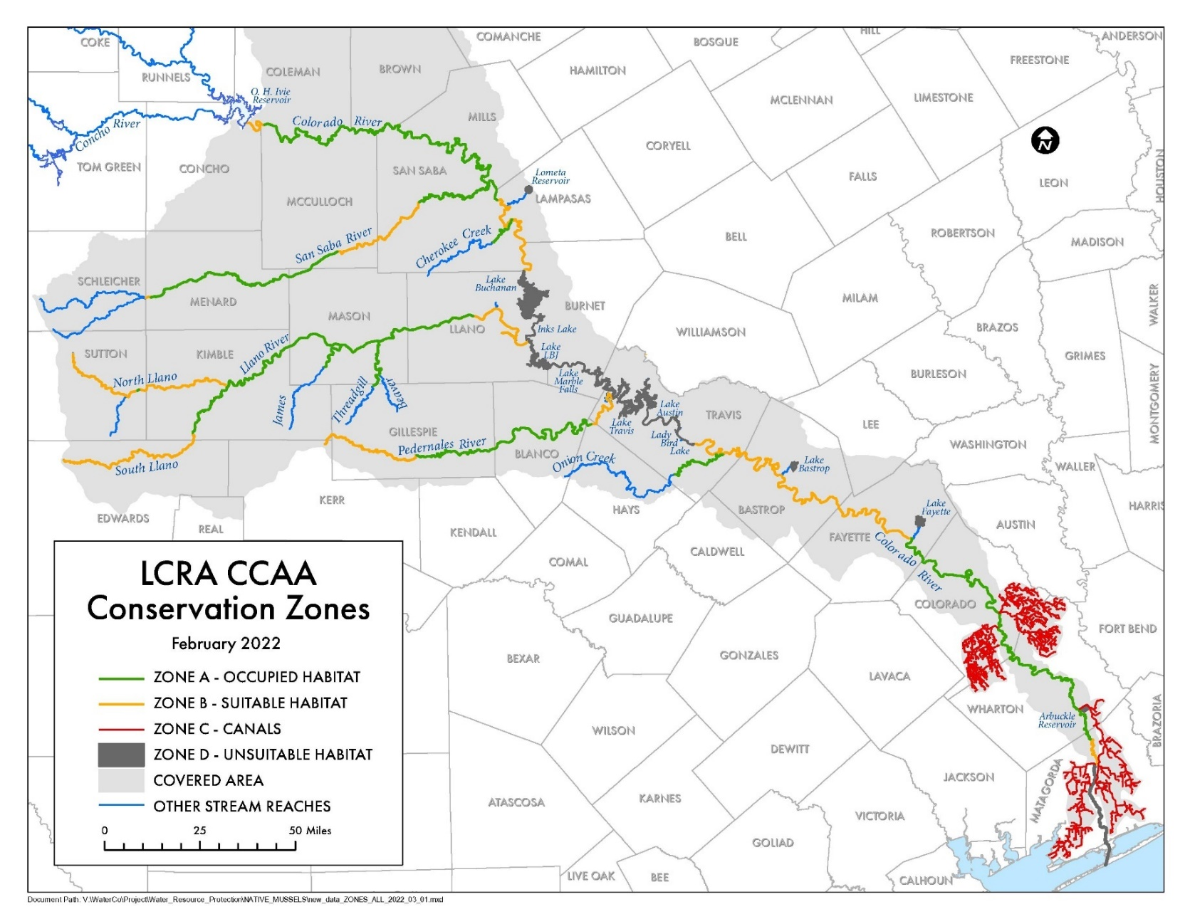
Covered Area
Zone A – occupied
Zone B – suitable habitat, unoccupied
Zone C – some perennial canals occupied
Zone D – not habitat (reservoirs and downstream of Bay City Dam)
Notes:
This slide shows where these mussels and their habitats are located within the LCRA Water Service area. The areas are delineated as Zones because the nature of the area will dictate what types of actions may be necessary to comply with the Endangered Species Act.
The green lines - Zone A – show the river segments with known, occupied habitat today.
2 of the mussels occupy the river from Fayette Power Project downstream to Wharton/Matagorda County line.
Collectively, all 4 of the mussels occupy sections of Onion Creek; the Pedernales, Llano, and San Saba rivers; and in the Colorado River below O.H. Ivie downstream to just below the confluence with the San Saba River.
The yellowish-orange lines, which are called Zone B, depict river segments generally considered to have suitable habitat for these species but there is no known occupancy at this time.
You will see the red lines are our canal system, which we call Zone C. It turns out that the few canal sections kept in operation year-round for our industrial customers also provide habitat for the same mussels that are found in the lower river. Either the mussels themselves or their host fish get taken up when we divert water from the river into these canals. Because the water keeps flowing in the canals, the mussels can survive.
Finally, you will see here that Zone D delineates areas that are considered as unsuitable habitat for these mussels– namely, the reservoirs and the Colorado River downstream of the Bay City Dam where salinity can be too high for the mussels. Although we do have other, more common freshwater mussel species in our reservoirs, these particular mussels need flowing water and only live in rivers.

Slide 5
Covered Activities
CCAA-Related Measures
Operations
Inspections, maintenance and repairs
Dredging
Riverbank stabilization
Construction (limited)
Flood operations
Remediation/restoration
Use/maintenance of water crossings
Research & monitoring
Invasive species management
Notes:
Operations:
Water storage in and releases from reservoirs, including the Highland Lakes, lakes Bastrop and Fayette, and Arbuckle Reservoir;
Delivery, discharge, and diversion of water;
Provision of water to help meet environmental flow needs through reservoir releases or by restrictions on diversions;
Reservoir drawdowns to allow for maintenance of LCRA facilities, customer intakes, and lakeside residents’ repairs to docks and retaining walls;
Management of LCRA lands, including but not limited to habitat and vegetation management activities;
Provision of recreational opportunities on or near the Colorado River and its tributaries, including but not limited to parks, camping, hiking, fishing, motorized and nonmotorized navigation, water access (boat ramps, docks, etc.), events, camps, educational programs, aquatic obstacle courses, lodging on or near the water, and similar activities;
Generation of power, including discharge of process or stormwater;
Water safety activities, such as patrols, placement and maintenance of hazard and no-wake buoys and related signage, and occasional removal of navigation hazards;
Regulation and inspection of marinas and private docks;
Implementation of regulatory programs related to nonpoint-source pollution and on-site sewage facilities around the Highland Lakes;
Lake cleanup activities;
Access to LCRA and LCRA TSC infrastructure and facilities by LCRA personnel or contractors and guests, including access by vehicles; and
Operation of electric transmission facilities and substations.
** Construction – only include construction associated with the routine operation, repair, replacement, or maintenance of LCRA’s and LCRA TSC’s existing facilities, and installation of new equipment and structures associated with implementing any of the Conservation Measures described in this CCAA. No new infrastructure that has more than a minimal or temporary disturbance of the river or tributaries.

Slide 6
Conservation Strategy
Avoidance and Minimization Measures
Conservation Measures
Estimated total for both in-kind and out-of-pocket expenses over 20-year term:
$38,648,000
Notes:
Key commitments
No new on-channel dams/reservoirs
Limitations on new or modified diversion facilities to protect subsistence flows while allowing full pumping of our water rights
Collaborate on research and monitoring activities
Continued stewardship of land and water resources within the basin

Slide 7
Avoidance and Minimization Measures
No new on-channel dams/reservoirs
Limitations on new or modified diversion facilities to protect subsistence flows while allowing full pumping of our water rights
Reduce site-level disturbance
Construction & design BMPs
Canal relocations prior to dewatering in perennial canals
Work group focused on Onion Creek Tx fatmucket
Notes:
NOTE – if we trigger Sec. 7 USACE permitting, these are the FLOOR

Slide 8
Conservation Measures
Generally - collaborate on research and monitoring activities and continued stewardship of land and water resources within the basin
Specifics:
Water Quantity
Water Quality
Invasive Species
Population Enhancement and Protection
Land Conservation Measures
Notes:
Water Quantity – eflows; WMP; new science; water conservation; subordination agreements
Water Quality – eflows; temp and quality monitoring
Pop Enhancement – water for fish hatchery; field investigations; augmentation; contingency plan to use canals; work group
Land conservation – Creekside conservation; public outreach and education

Slide 9
Additional CCAA Components
Monitoring and Reporting
Adaptive Management Plan and Program
Incidental Take Estimates (Habitat Surrogate)
Regulatory Assurances
Changed or Unforeseen Circumstances
Notes:
+Changed Circumstances – not to exceed add’l $14k/year
New listing, delisting, threatened species rules
Taxonomic changes
Catastrophic events
Lack of self-sustaining population
E-flow standards or WR requirements
Predation/diseases/invasives
Host fish issues
Change in canals
Change in funding
-

Slide 10
