Slide 1
City of Austin Aquifer Storage & Recovery Project

Slide 2
Agenda
About Aquifer Storage and Recovery (ASR)
Technical Approach and Process
Community Outcomes Evaluation Process
Next Steps
Q&A

Slide 3
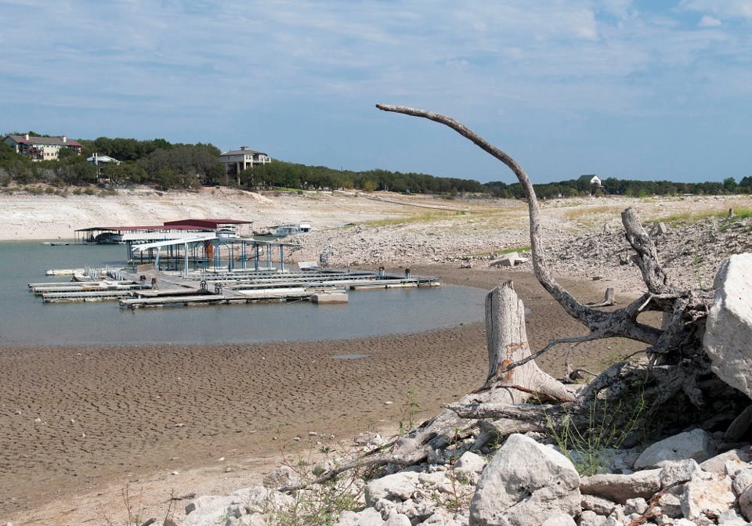
About ASR: Project Background
 | Aquifer Storage and Recovery (ASR) is a water supply strategy to store available water for recovery and use when we need it most.
 | Other cities around the US and here in Texas are already using ASR systems, including San Antonio, El Paso, and Kerrville.

Slide 4
About ASR: Project Background
 | ASR is part of the Austin City Council-approved Water Forward plan, which provides a roadmap for Austin’s water future for the next 100 years.
 | In 2021, Austin Water (AW) began a study to determine if aquifers in our region are suitable for AW’s ASR project.
Notes:
Other cities are using ASR

Slide 5
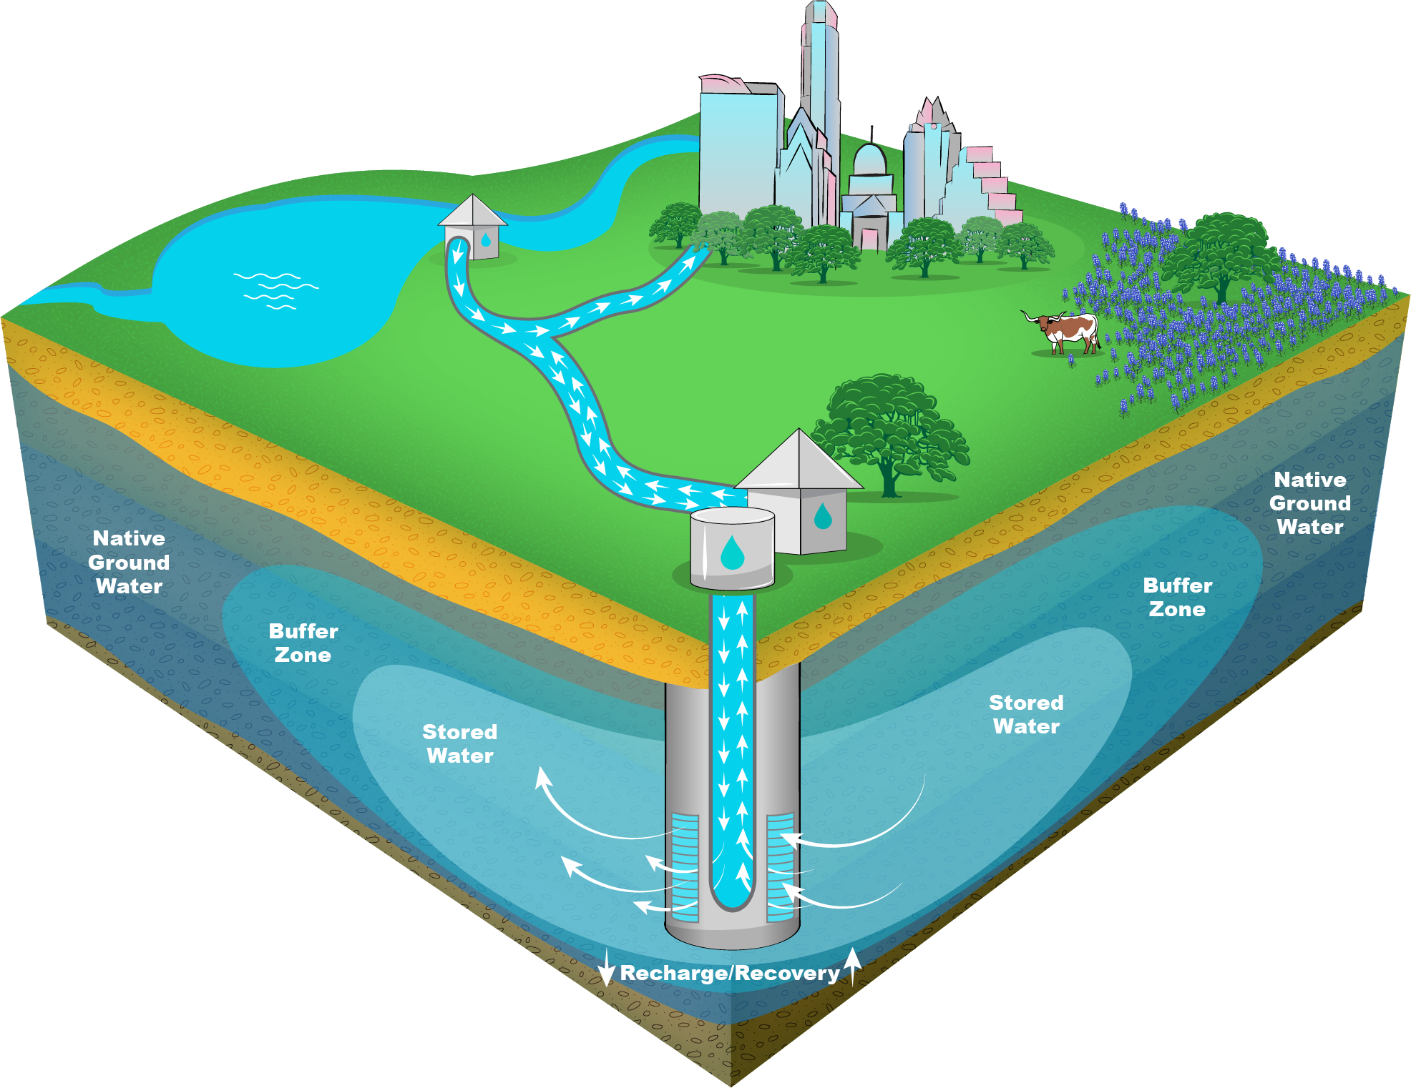
About ASR: How It Works
Available water from Austin’s drinking water system is pumped into an aquifer underground for storage when water supplies are plentiful. Water is stored until it is needed.
When Austin’s regular water supply becomes low, the stored water is pumped out of the aquifer.
Stored water is tested and treated before it is distributed to customers in AW’s system.

Slide 6
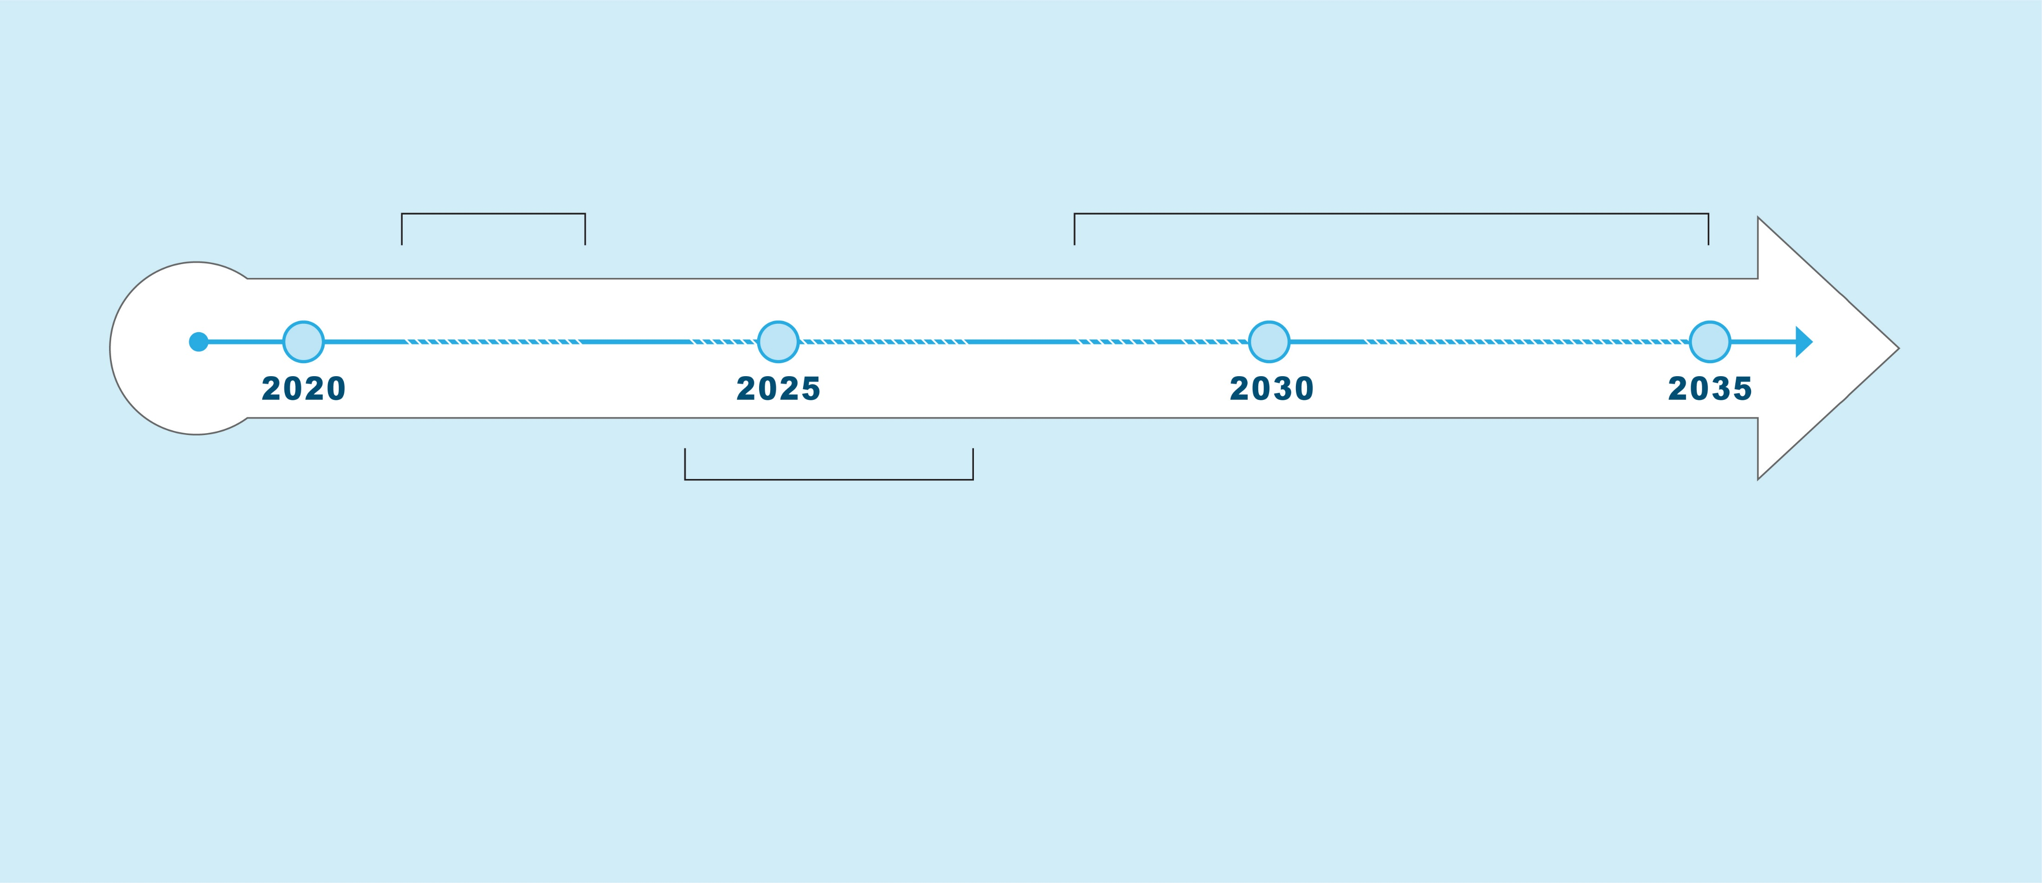
About ASR: Project Timeline
2021-2023
Identify locations for testing and possible projects
2028-2035
Design and construction of full-scale ASR project
2024-2027
Conduct field testing and small-scale project testing to develop recommendations for a full-scale ASR project

Slide 7
ABOUT ASR: Location Evaluation Process
STEP 1
Gather data on a broad range of feasible ASR project options over a wide spatial area
Gather initial equity and affordability data
Completed
STEP 2
Compare technical favorability of ASR project options
Gather community input on the equity and affordability framework
In progress
STEP 3
Select ASR location(s) that are technically favorable and align with equity & affordability goals
Next steps

Slide 8
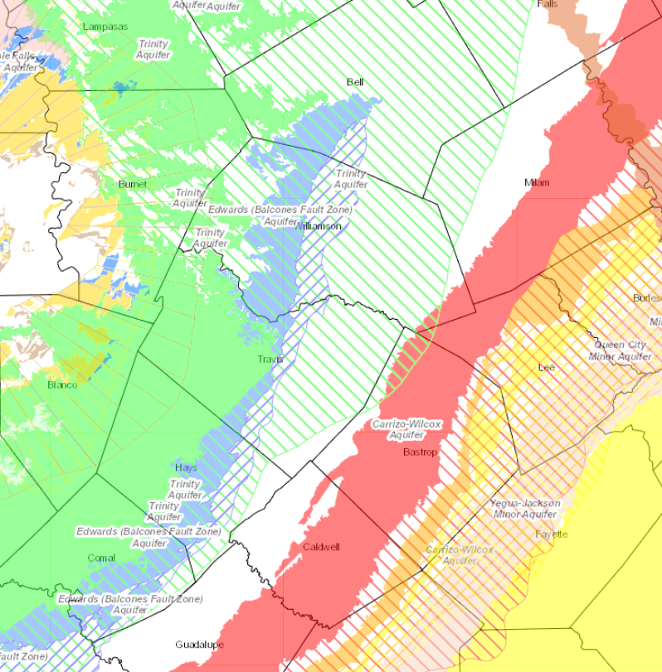
About ASR: Finding favorable aquifers
Goal of this phase of work is to identify potential locations for an ASR project
Looked over a broad range to determine favorable aquifer areas for ASR

Slide 9
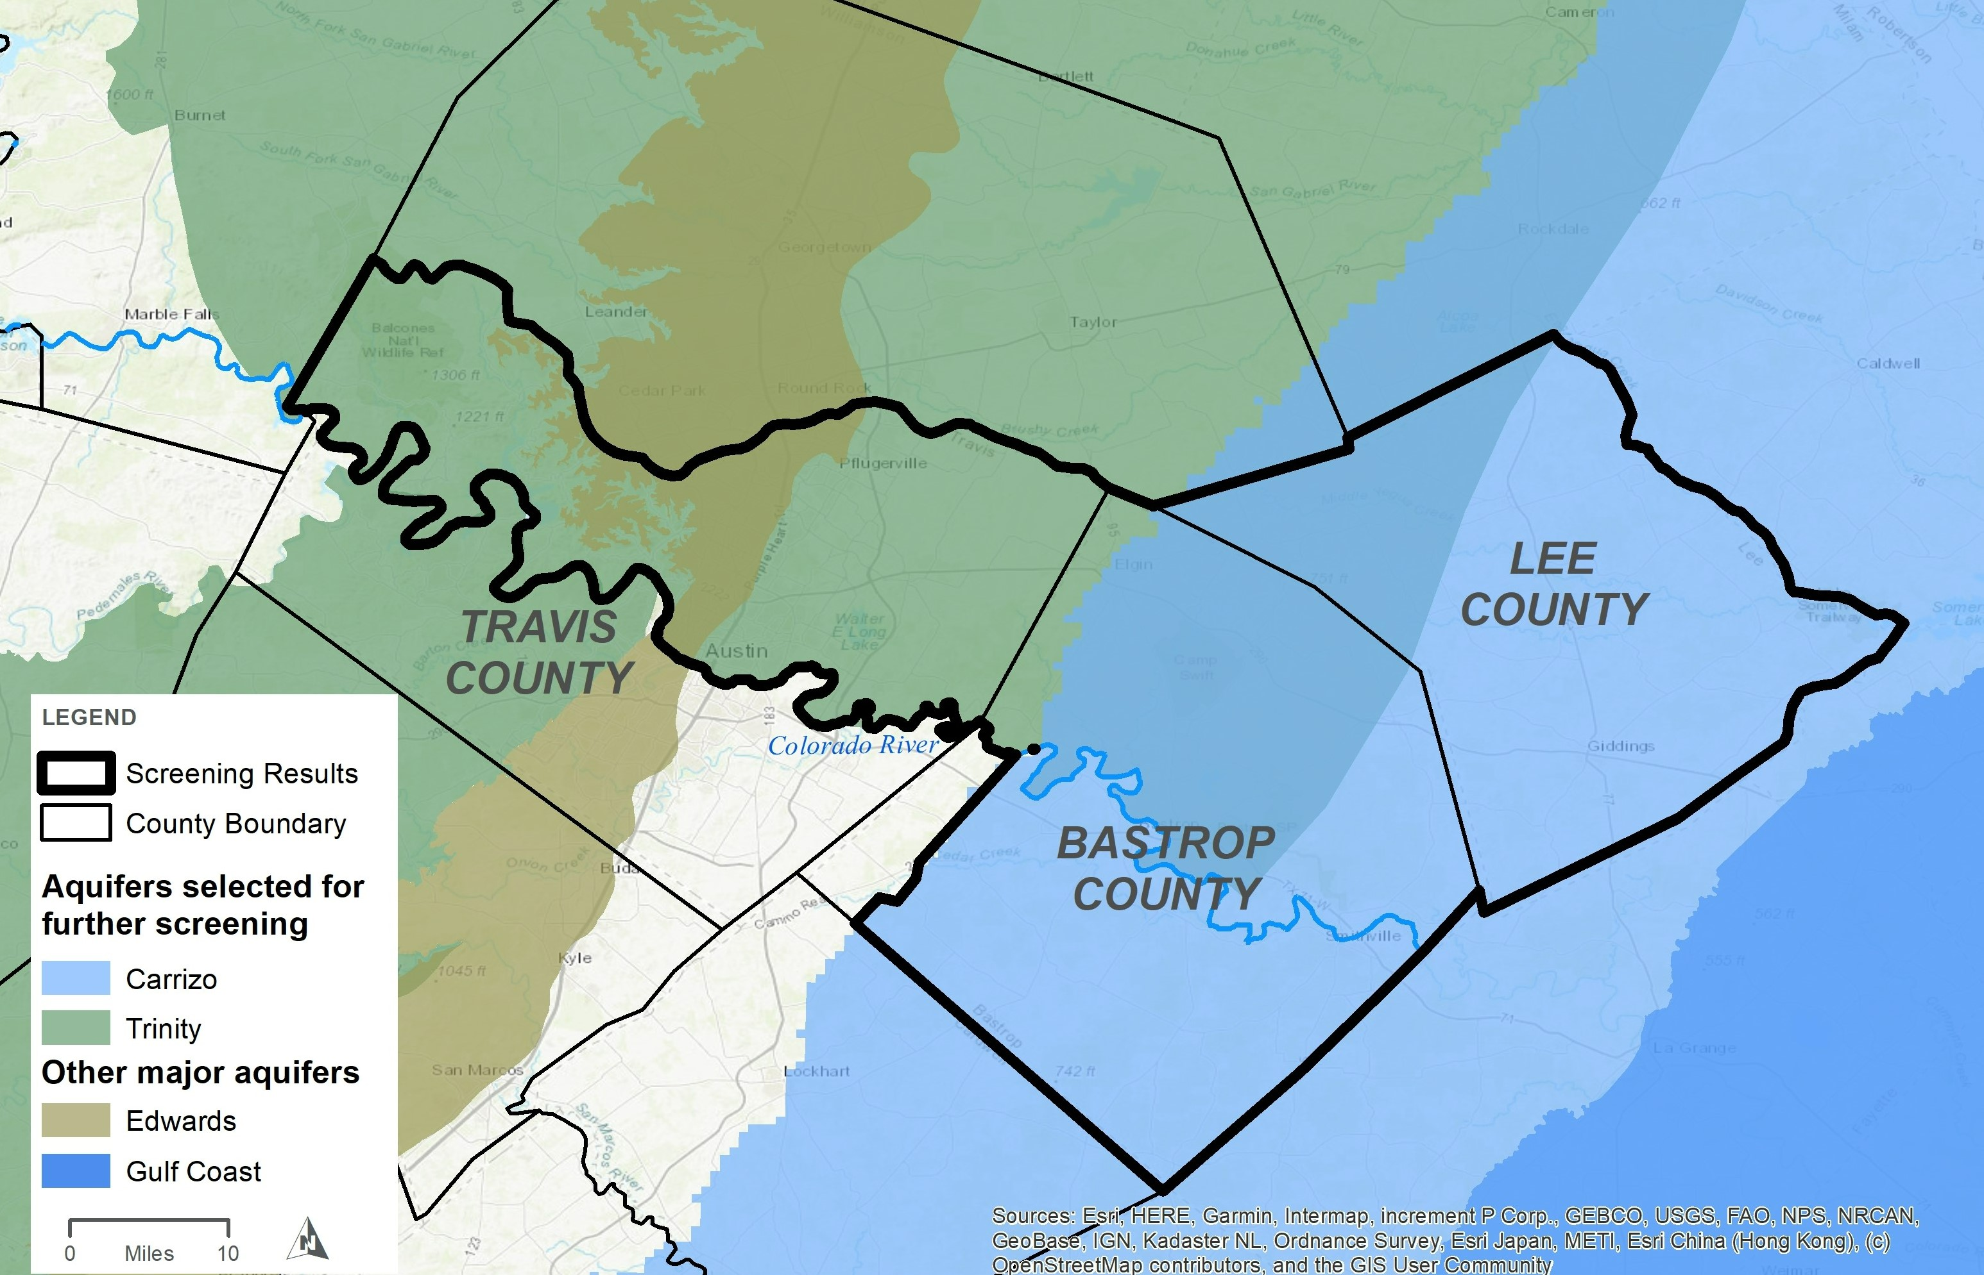
Results: Favorable Aquifer areas
Carrizo-Wilcox and Trinity aquifers in Travis, Bastrop, and Lee Counties
Perform focused desktop analyses in these areas to identify potential ASR sites

Slide 10
Technical Analysis: Criteria
30 % Hydrogeology | 7.5% | Recovery efficiency | 30% Operations | 5% | Energy
 | 7.5% | Max recovery rate |  | 10% | Complexity
 | 7.5% | Max storage capacity |  | 15% | Resiliency and flexibility
 | 7.5% | Time to refill ASR
20% Cost | 12% | Operations & maintenance cost | 20% Implementation | 4% | Constructability
 |  |  |  | 4% | Space requirements
 | 8% | Capital cost |  | 8% | Land agreement complexity
 | 8% | Capital cost
 |  |  |  | 4% | Wildlife habitat

Slide 11
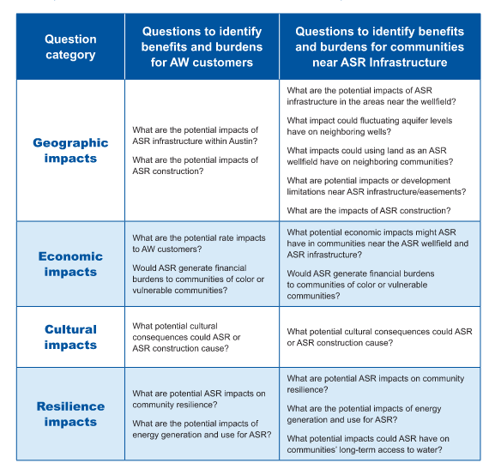
Community outcomes evaluation: Approach
Tool to help understand potential benefits and burdens from the ASR project.
Evaluating effects to AW customers and communities near ASR project infrastructure.
Tool will help identify potential project adjustment and mitigation strategies.
Notes:
Amy
Roadmap describes the history and makes recommendations to help incorporate equity in the way ASR is implemented
The equity and affordability tool is geared towards incorporating equity into how ASR is implemented, and used a framework of questions identified in the road map when considering project alternatives.
Community workshops in fall 2022 sought input from community on the questions included in the EAT
Tool helps team understand benefits and burdens for different ASR project options
For both AW customers and people near infrastructure
Results of the tool analysis will be used in conjunction with technical data to recommend a location for ASR piloting and testing

Slide 12
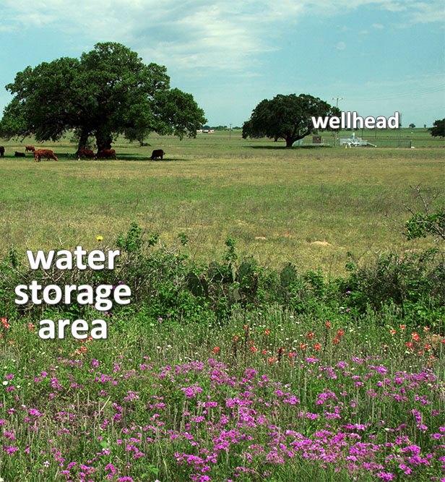
Community outcomes Evaluation: Project Benefits
 | To protect stored water, the land over ASR would be protected and preserved.
 | Although well levels may fluctuate, ASR provides a net benefit to the aquifer since it would only recover previously stored water.
 | Project will implement mitigation strategies for local communities near ASR infrastructure.
https://www.edwardsaquifer.net/asr.html

Slide 13
Community outcomes Evaluation: Mitigation strategies
 | Perform well-lowering/mitigation for existing well owners impacted by potential aquifer fluctuations due to ASR.
 | Fund additional monitoring and research of the aquifer and groundwater in the region through partnerships.
 | Leaseback of ASR wellfield land for continued use compatible with ASR (for example, for continued agricultural use).

Slide 14
ASR Phase 1a: Next steps
Phase 1a (desktop analysis) is planned to wrap up in Spring 2024.
Community open house events are planned for February 2024.
Field testing for the next phase of ASR is anticipated to begin in Fall 2024 at the earliest.

Slide 15
Learn More
AustinTexas.gov/ASR
SpeakUpAustin.org/ASR

