Slide 1

Tapping Lake Travis
Phase 2 Raw Water Delivery System
Karen Bondy, PE
General Manager

Slide 2
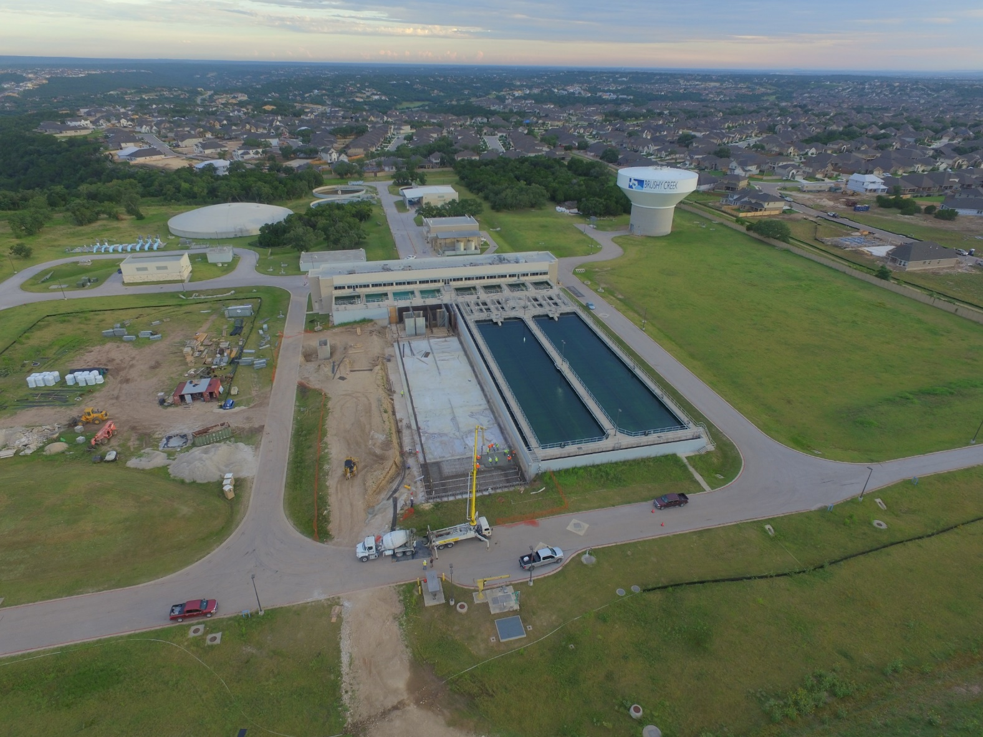
BCRUA Regional Water System
Partnership of Cedar Park, Leander and Round Rock
Formed in 2007
Regional partnership reduces costs and environmental and community impacts
2020 Expansion to BCRUA WTP

Slide 3
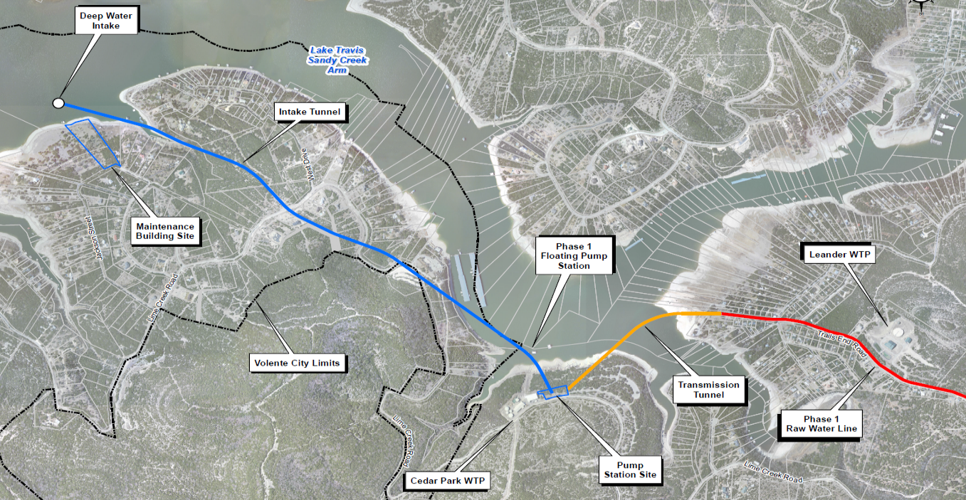
Project Overview & Layout
145 MGD ultimate capacity
Components:
  Deep water intake
  Maintenance building
  Intake tunnel
  Pump station
  Transmission tunnel
Delivery to 3 WTPs

Slide 4
Project Planning and Construction
Contractor: Thalle | SAK Joint Venture
Construction Manager: Walker Partners | FNI Joint Venture
NTP issued June 22, 2022
Final Completion April 17, 2027
Contract amount: $224.8 M – TWDB SWIFT Funding
Planning
Construction
2005
2007
2015
2022
2027
Design & Land Acquisition

Slide 5
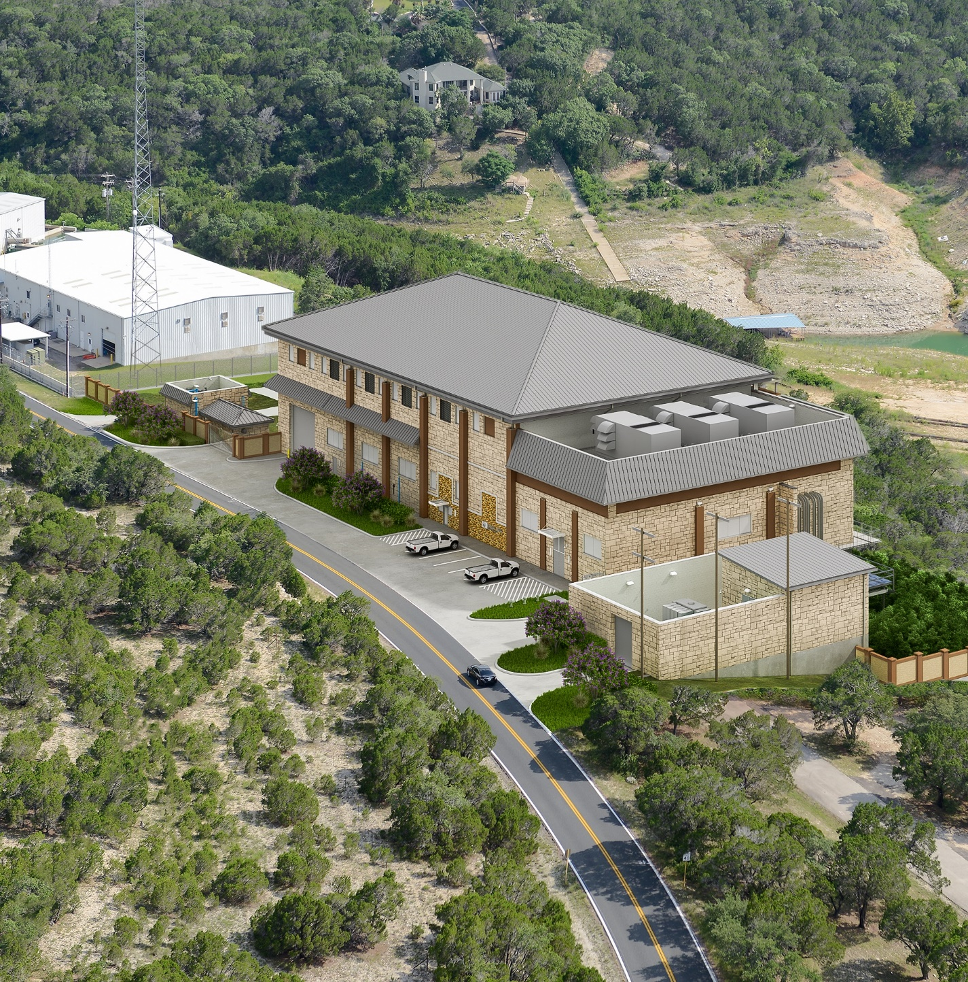
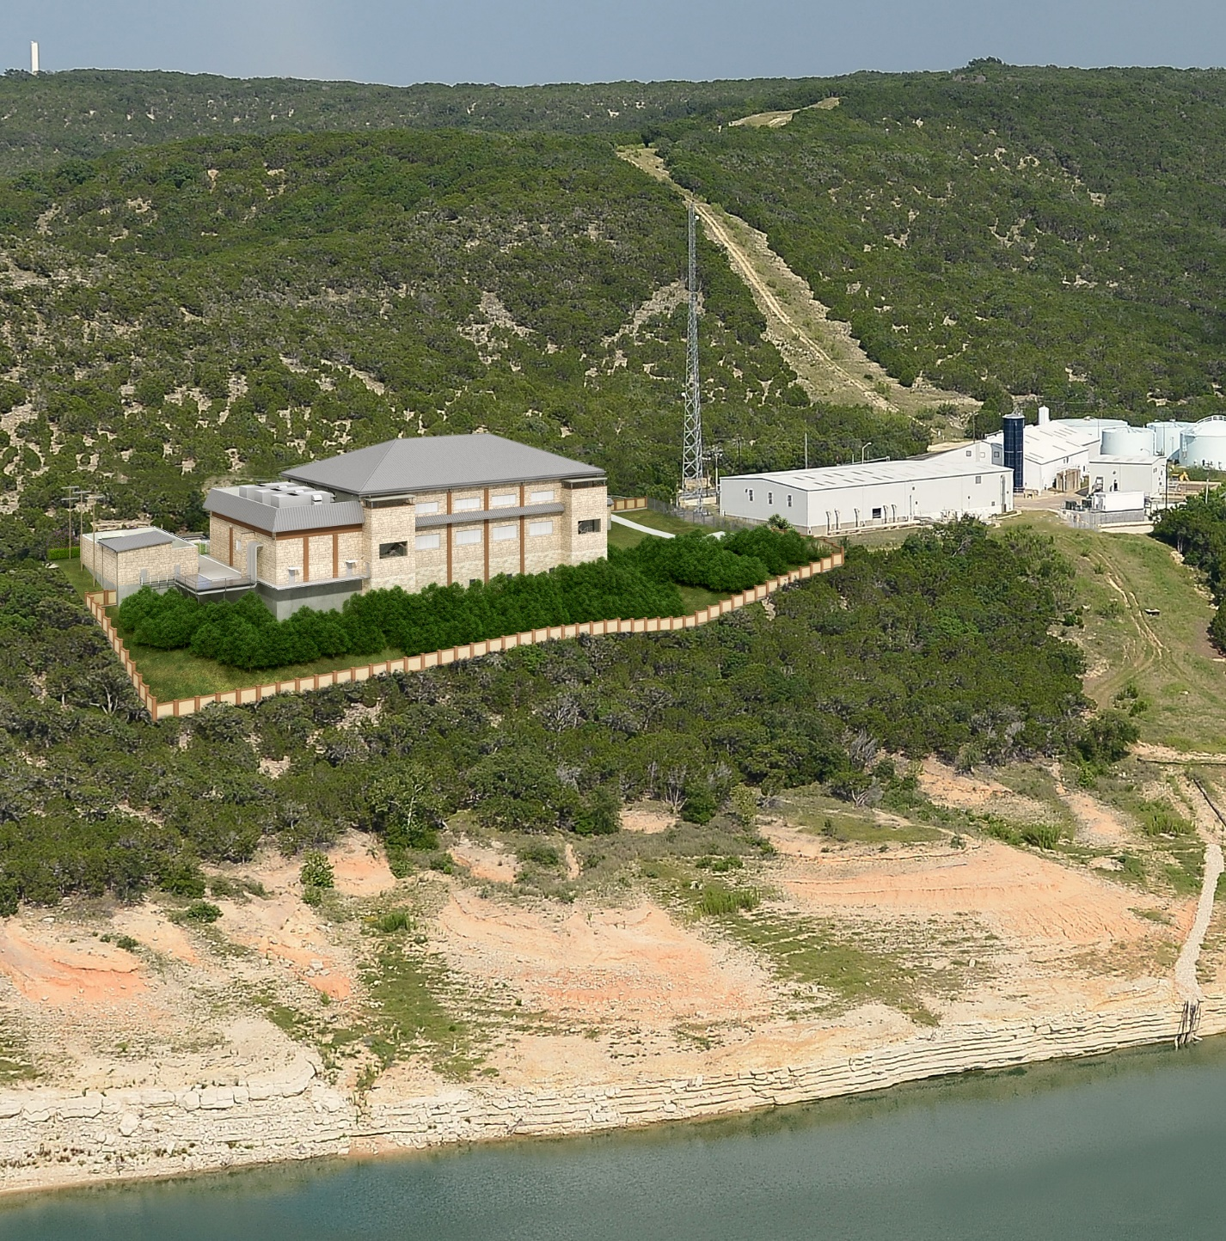
Pump Station

Slide 6
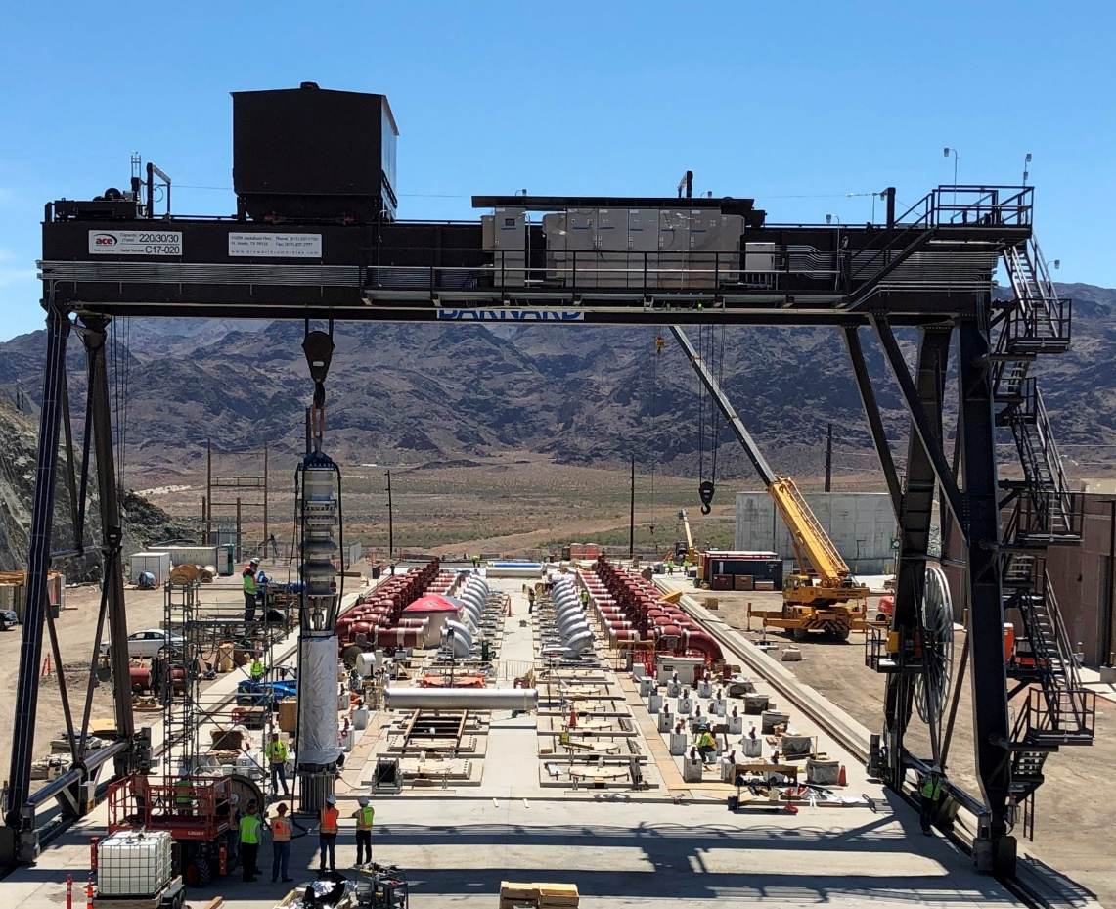
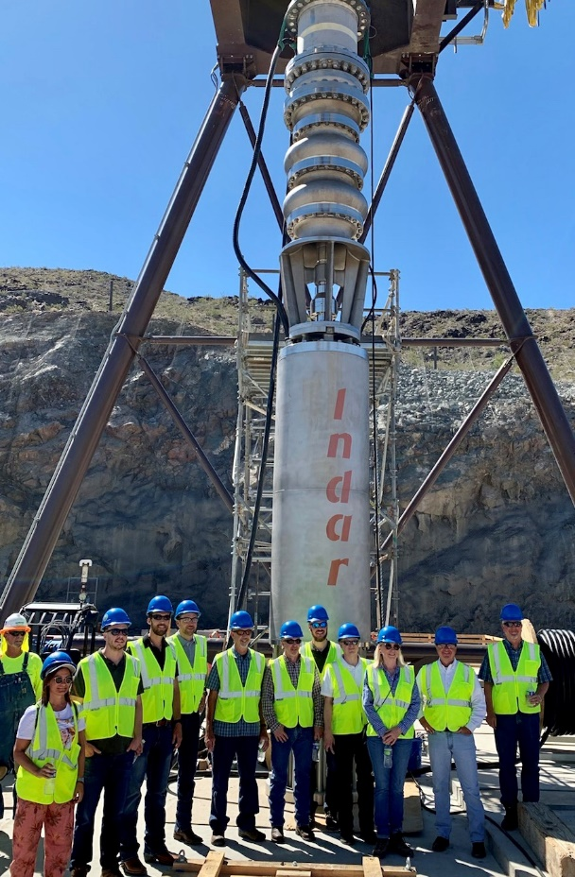
Pump Selection
Submersible pumps and motors:
  Simplify maintenance
  Reduce noise
  Eliminate potential line-shaft strain/vibration issues
Two separate pumping systems (27 MGD and 118 MGD)
Three pump designs (550, 2,000 and 3,600 HP)
SNWA Lake Mead L3PS Project
Notes:
Pump station designed as 2 separate pumping systems within a single pump station
One sends…
Due to depth of the installation, elected to use…
Initial design includes 3 different
pump selection is very important to BCRUA and the design team so we are procuring pumps as negotiated bid item
Bidders will submit pump manufacturer proposals for our team to evaluate on the basis of cost and non-cost factors such as local service capabilities, ability to meet performance and testing requirements and pump manufacturer quals and experience
Pump station designed as 2 separate pumping systems within a single pump station
One sends…
Due to depth of the installation, elected to use…
Initial design includes 3 different
pump selection is very important to BCRUA and the design team so we are procuring pumps as negotiated bid item
Bidders will submit pump manufacturer proposals for our team to evaluate on the basis of cost and non-cost factors such as local service capabilities, ability to meet performance and testing requirements and pump manufacturer quals and experience

Slide 7
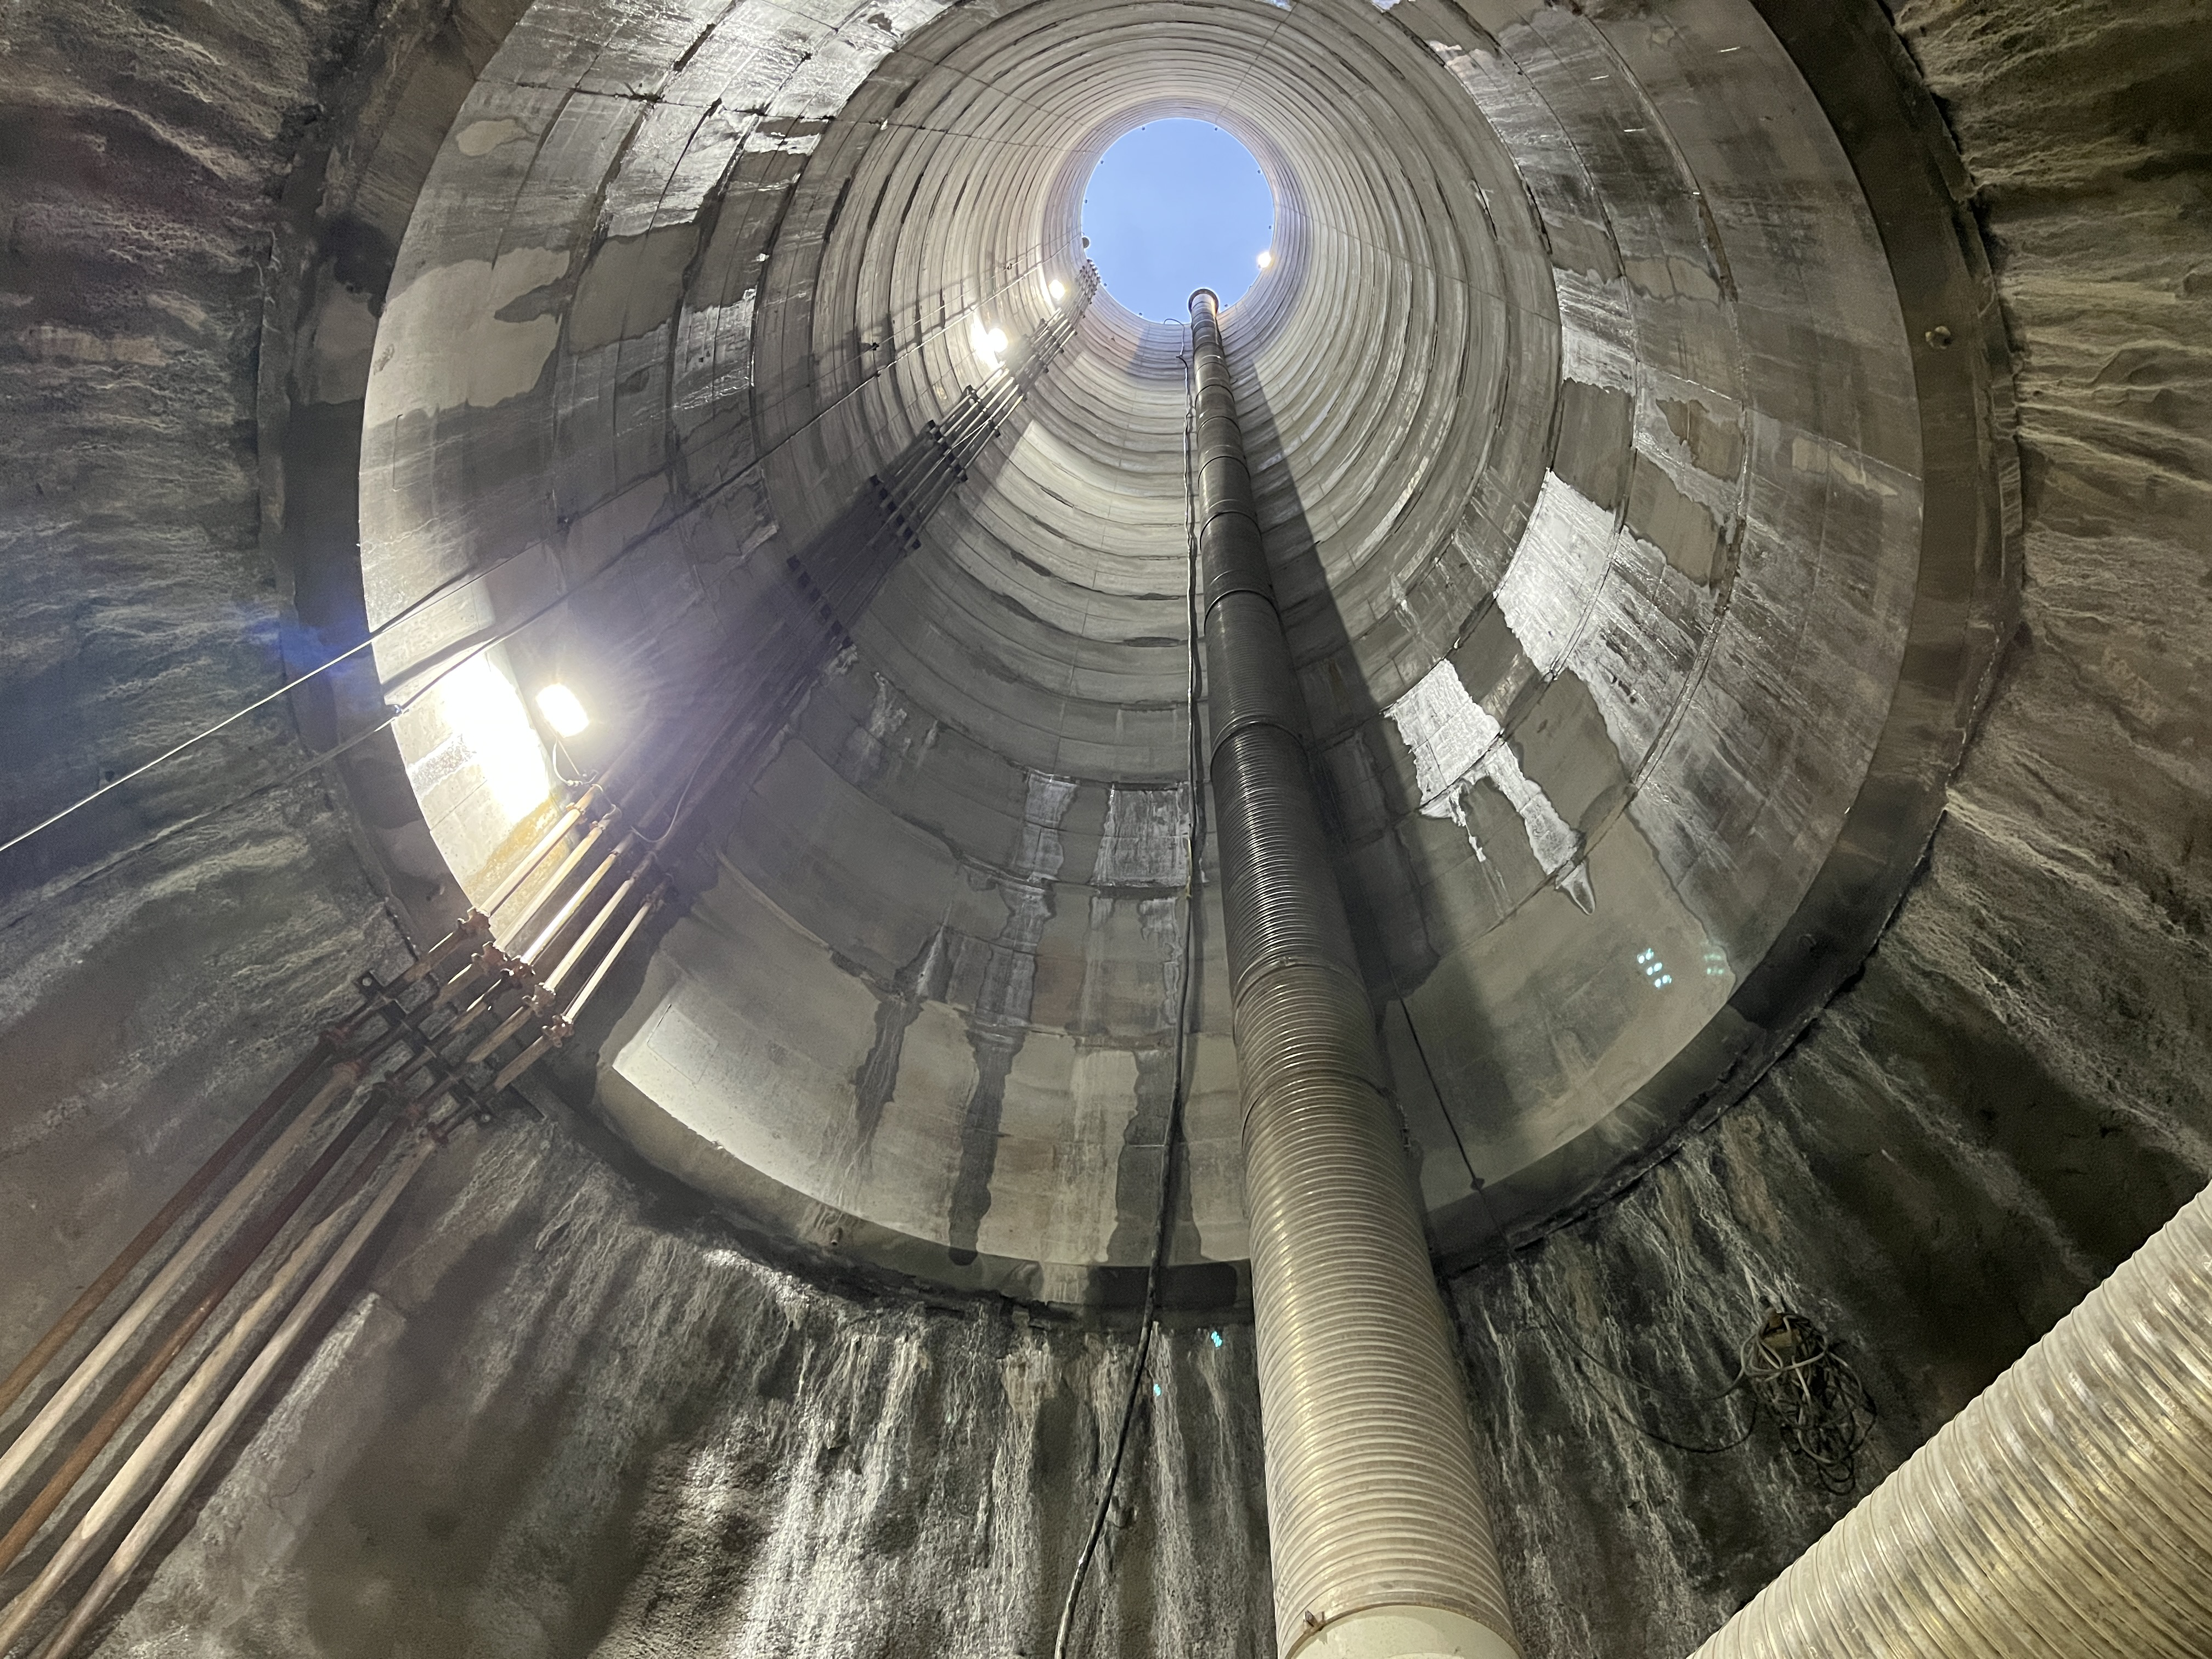
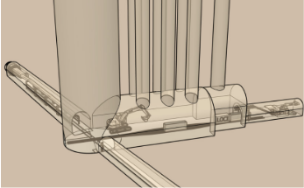
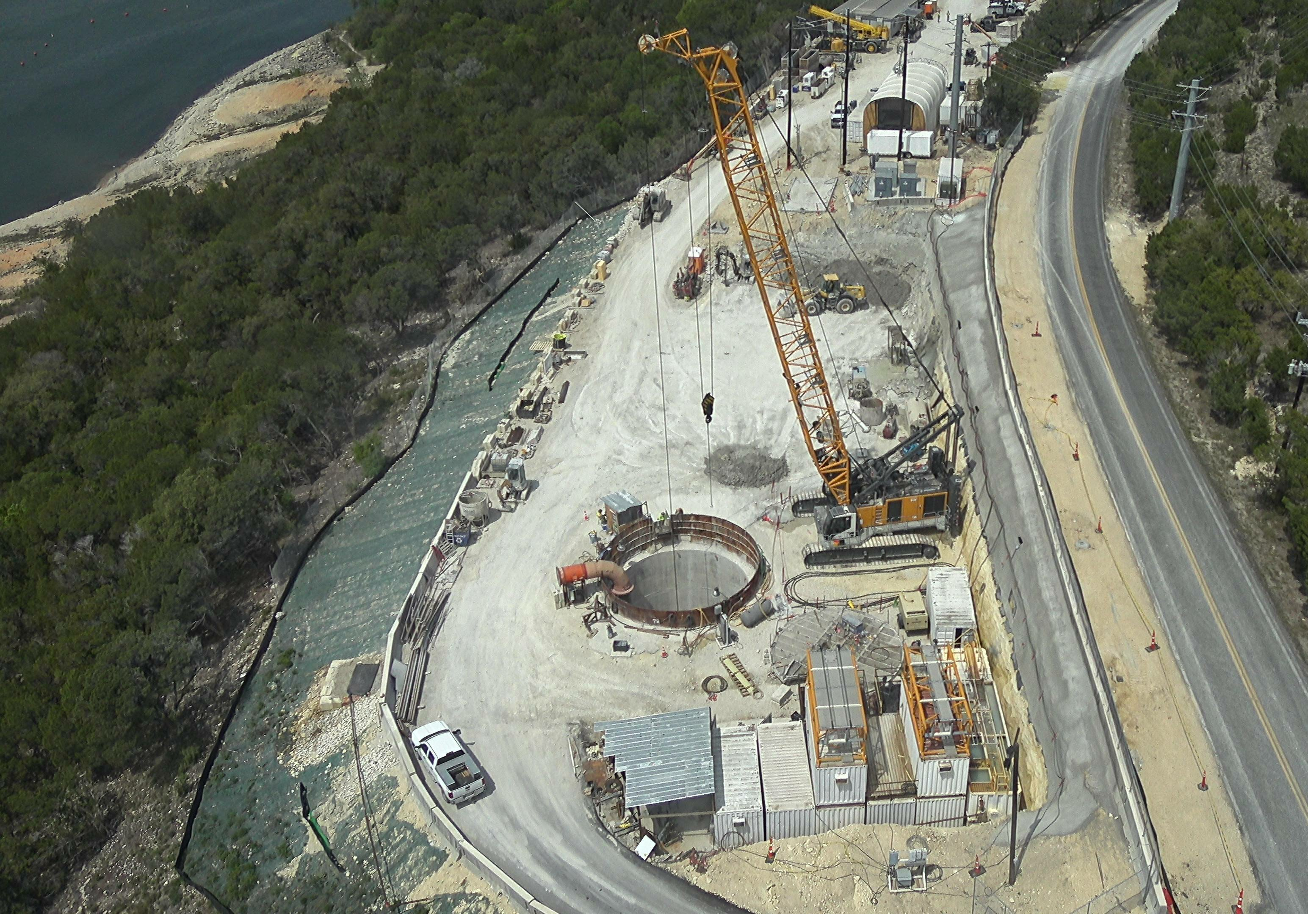
Main Shaft
Access shaft for all underground work
Diameter: 30 ft, Depth: 300 ft
Tunnel Boring Machine (TBM)
Notes:
6 Pump Shafts to connect the suction chamber and pump station (8 ft OD, 6 ft ID)
Discharge Shaft (9 ft OD, 7 ft ID) for transmission pipeline

Slide 8
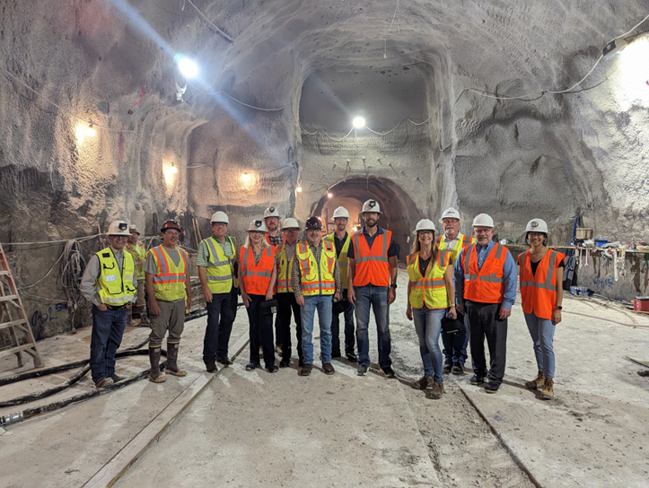
Suction Chamber
Connects the tunnels and shafts at the pump station
86.5 ft L x 28.5 ft W x 20 ft H
Notes:
6 Pump Shafts to connect the suction chamber and pump station (8 ft OD, 6 ft ID)
Discharge Shaft (9 ft OD, 7 ft ID) for transmission pipeline

Slide 9
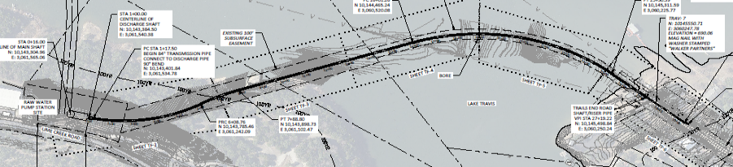
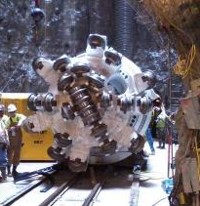
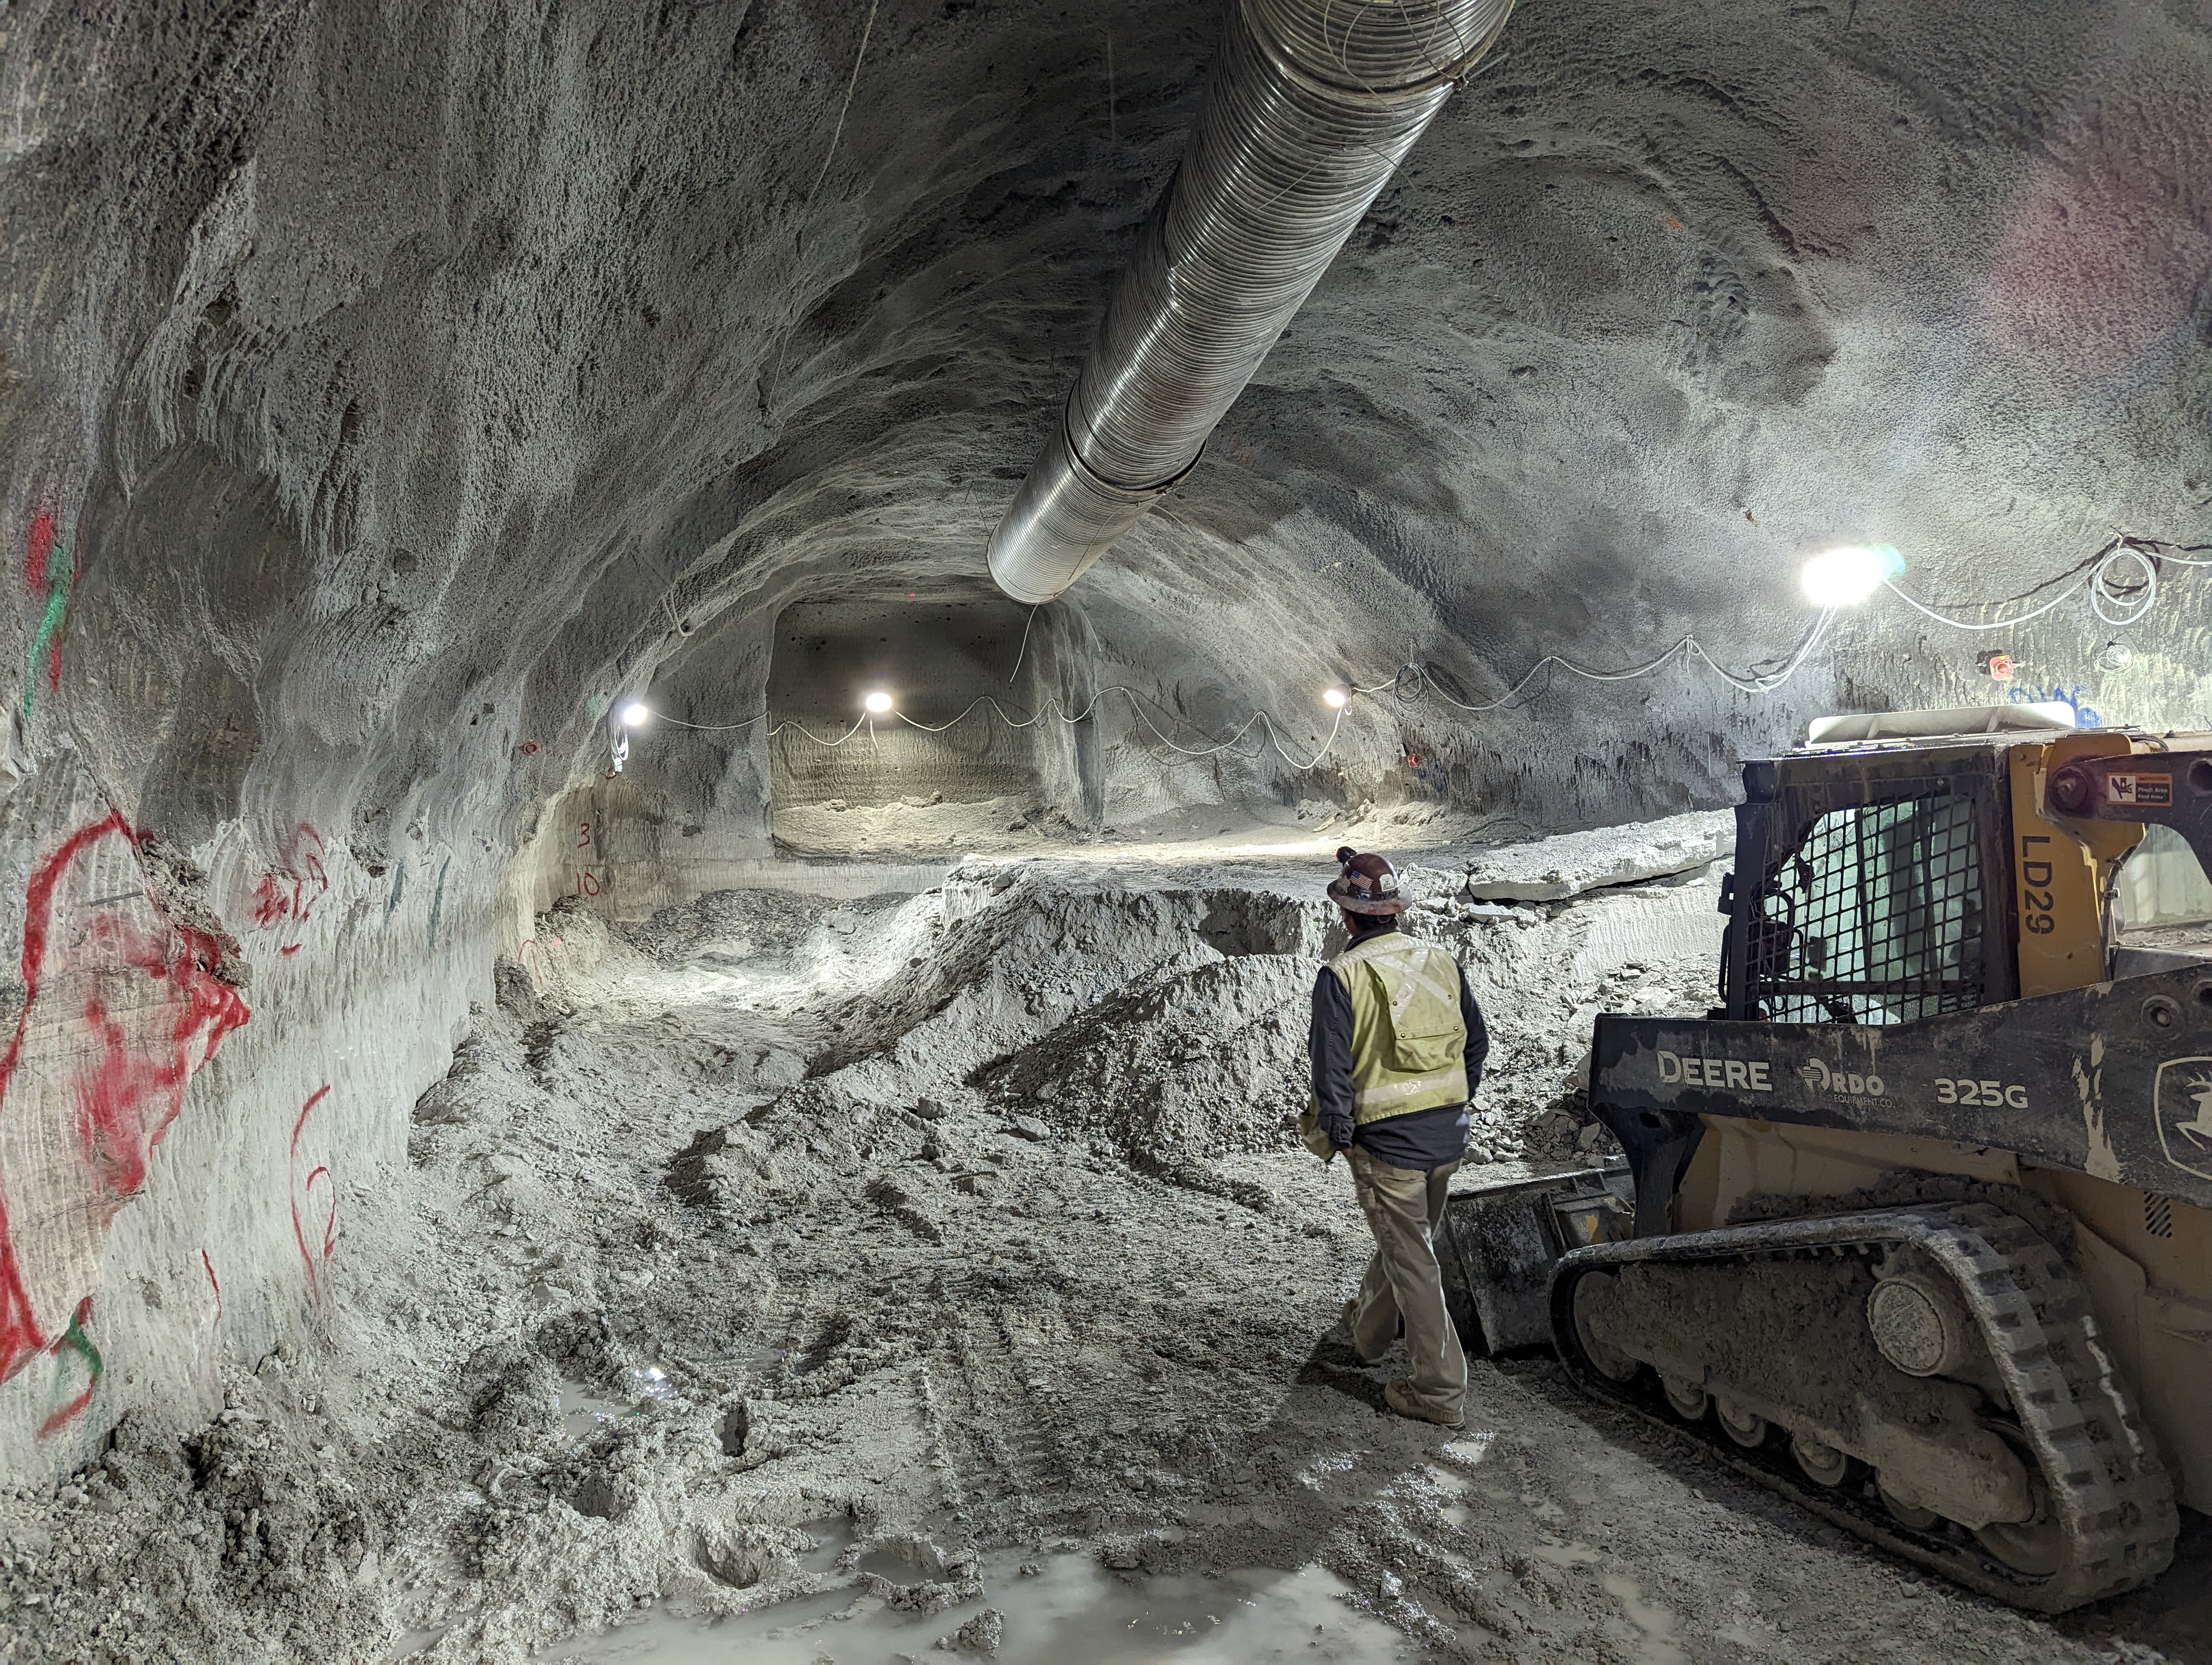
Transmission Tunnel
Transmission Tunnel
Trails End Road Shaft
Pump Station Site
Connect Pump Station to existing transmission main
2,600 LF at 3% Slope
Open rock TBM (11 ft diameter) excavation
Excavation duration ~ 3 months
Tunnel Boring Machine (TBM)
Trails End Road Shaft
Existing Transmission Main

Slide 10
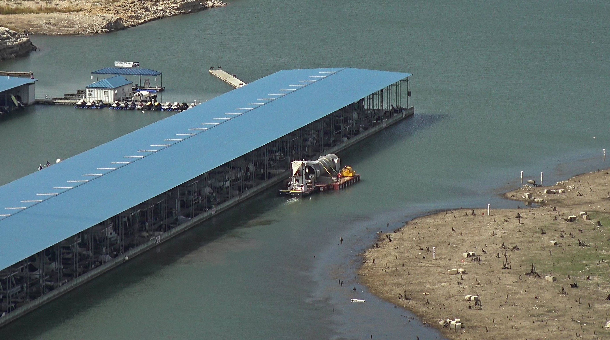
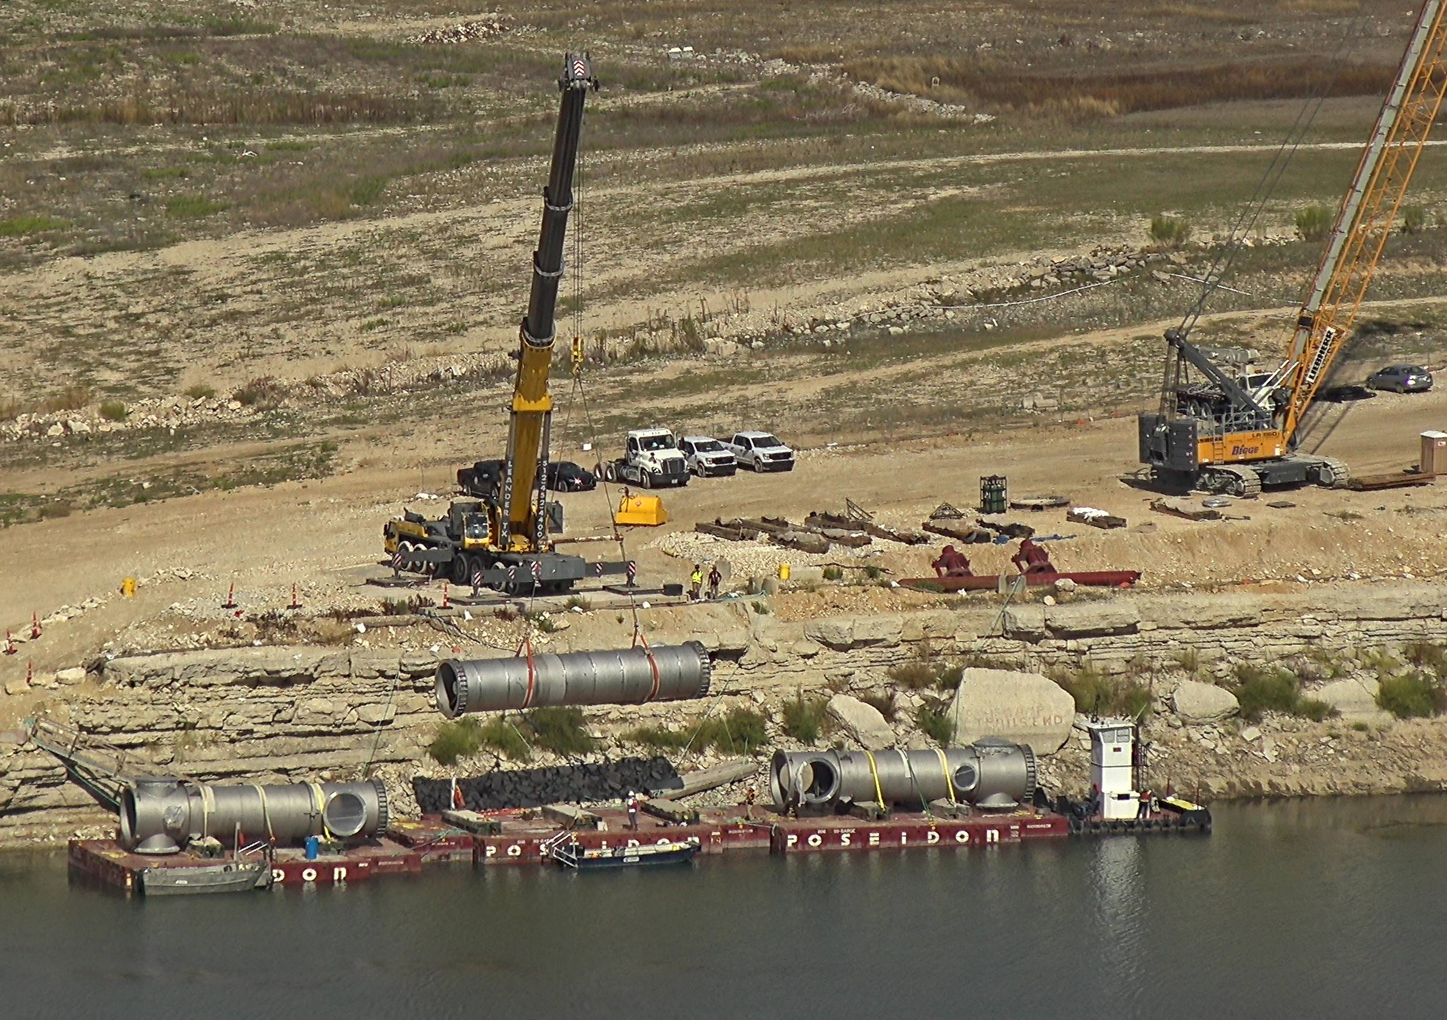
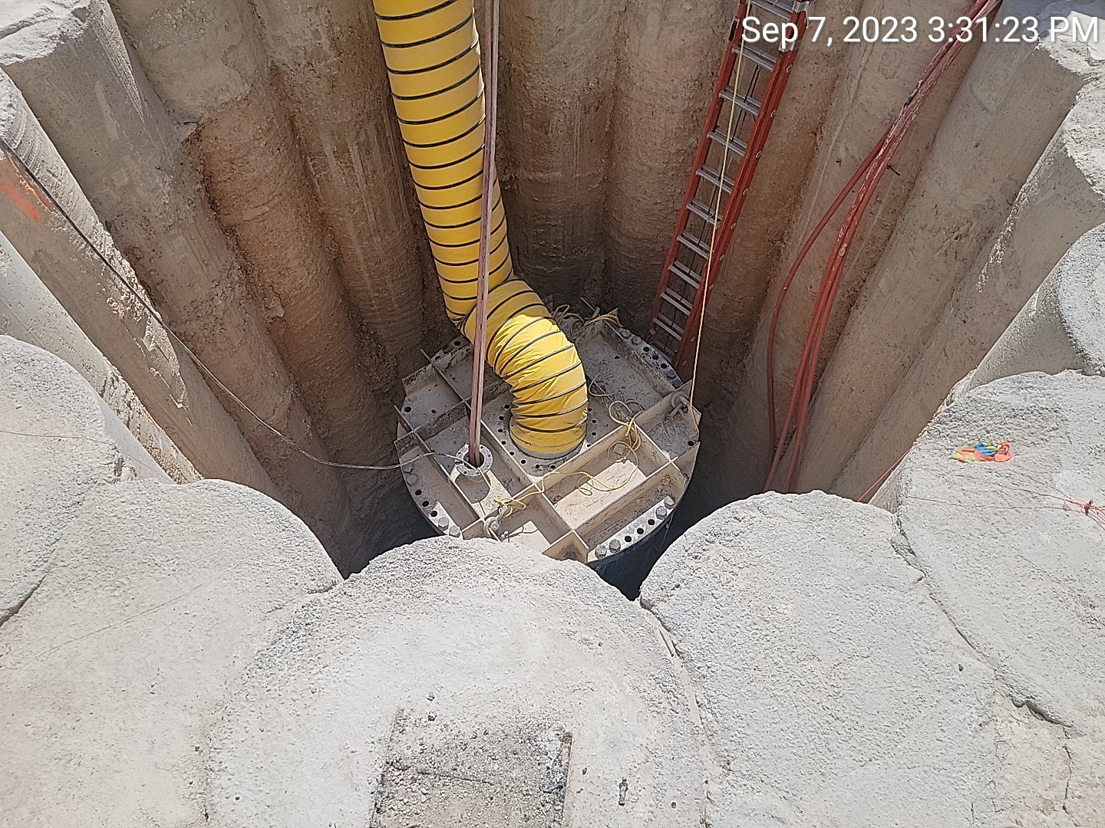
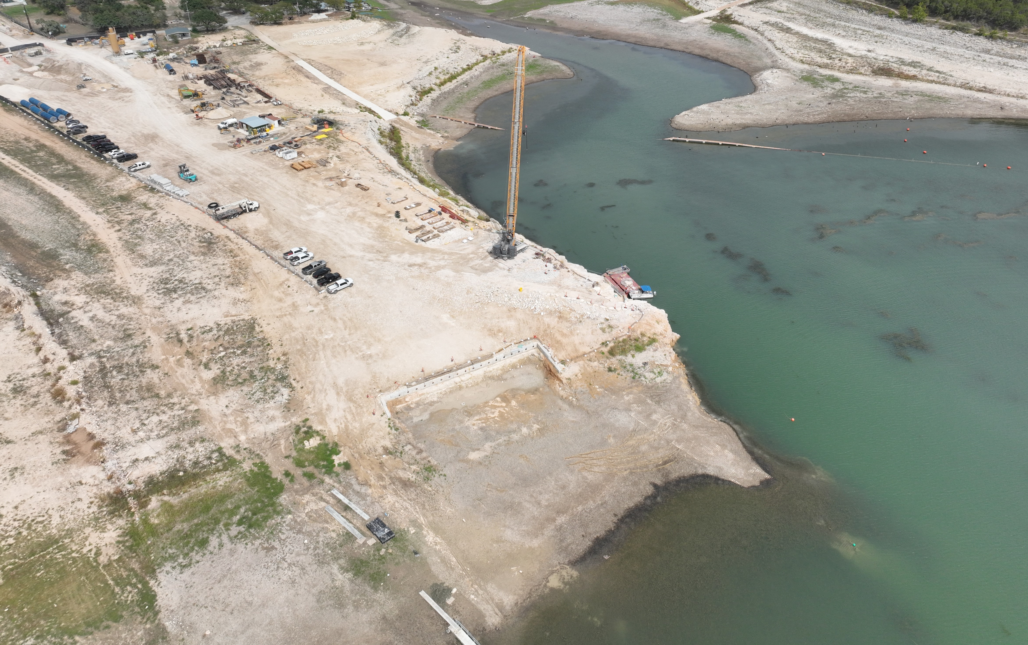
Trails End Road Site
Installing storm pipe and preparing for open cut work in ROW
Marine staging becoming more difficult due to low lake levels
Loading Intake Pipe on Barges
Top of TER Shaft
Low Lake Levels
Notes:
Connect Transmission Tunnel & existing Ph. 1 transmission main
130 feet deep, 10 ft diameter shaft with secant pile wall
Blind bore construction

Slide 11
Intake Tunnel
Connects intake risers to pump station
  Length: 8,800 LF
  < 0.1% grade from intakes to PS
  Several reverse curves based on easements
  Internal Diameter: 8 feet
  Final Liner: 1-ft thick CIP
Tunnel Boring Machine (TBM)

Slide 12
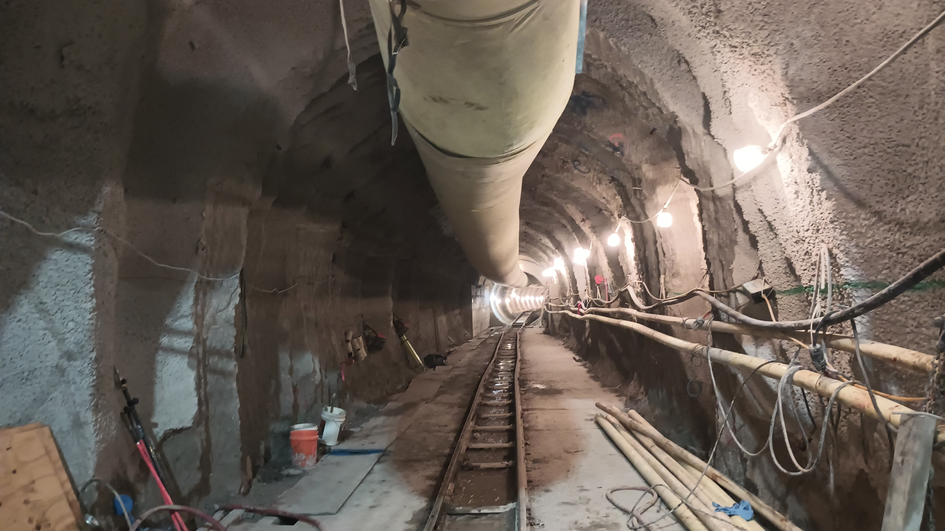
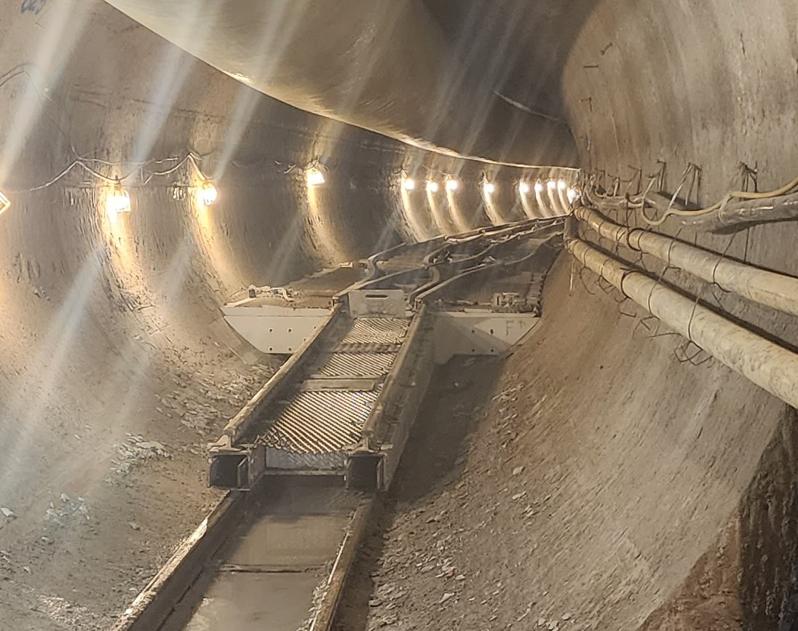
Intake Tunnel
Intake tunnel advancing at 200 feet per day
TBM arrival at intakes early November
Tunnel Boring Machine (TBM)
Intake Tunnel
Intake Tunnel Switching Station

Slide 13
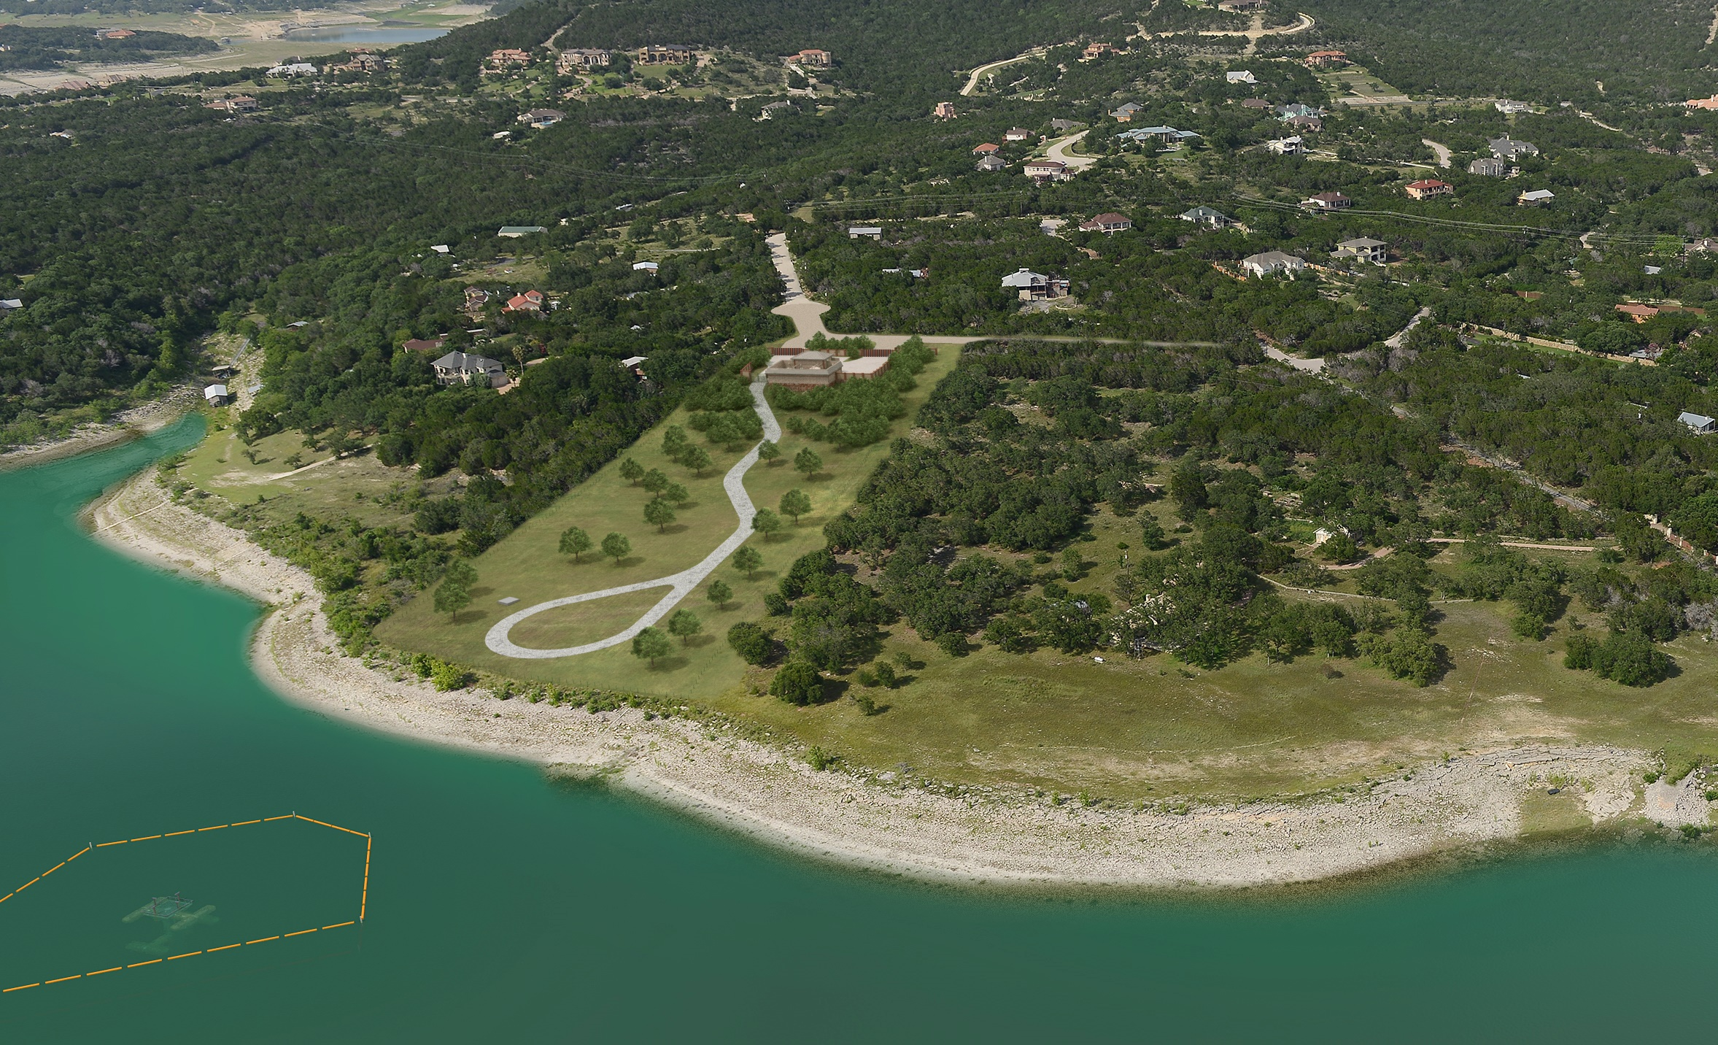
Intake & Maintenance Building

Slide 14
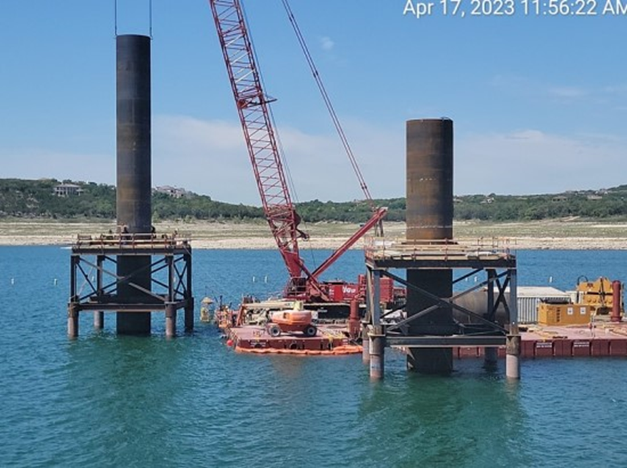
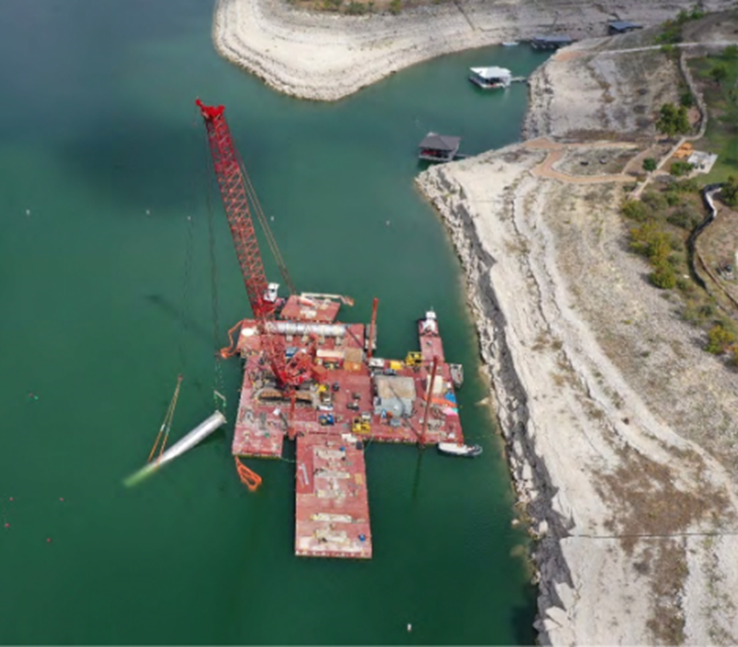
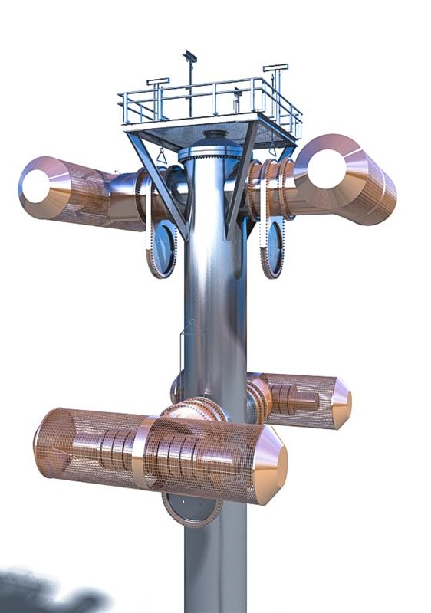
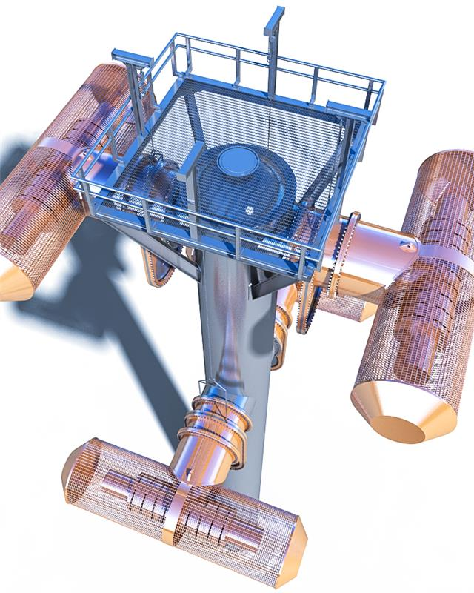
Intake Facilities
Withdraw water at multiple elevations due to water quality
Two lake taps on tunnel CL
Stacked screens - 4 levels
~ 30’ Spacing (656’ to 566’ msl)
Zebra Mussels on RW Pump
Notes:
Installed both riser pipes in lakebed
Grouting risers in place
Preparing to install intake upper sections

Slide 15
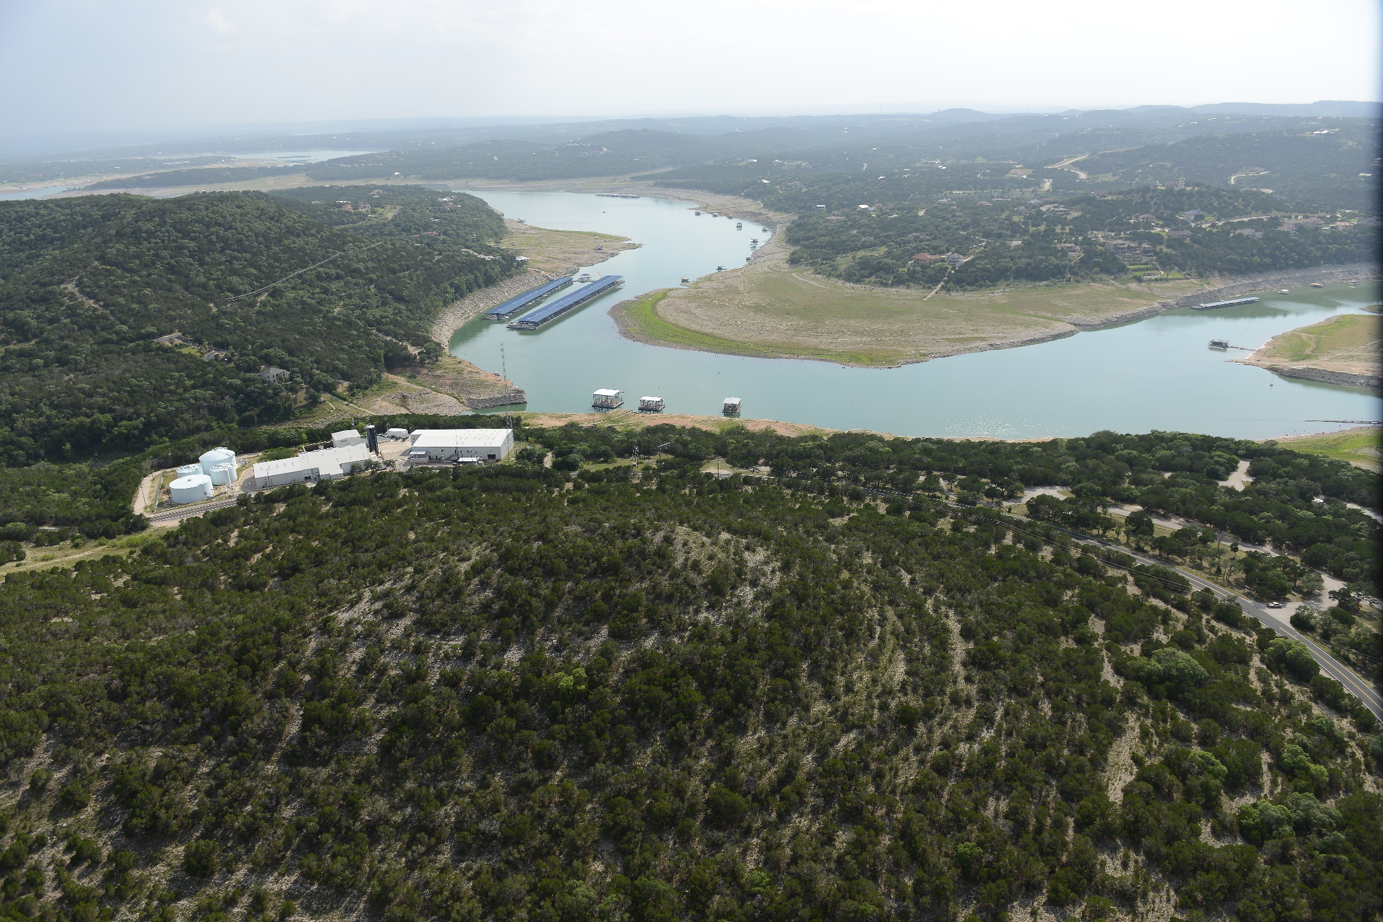
Third Party Coordination
U.S. Army Corps of Engineers
City of Austin
Travis County
LCRA
Village of Volente
Balcones Canyonland Preserve
Texas Commission on Environmental Quality
Texas Water Development Board
Acquisition of land rights on 202 parcels
$25M of power supply upgrades

Slide 16










Questions?
Tunnel Boring Machine (TBM)
Notes:
Mention Sara Thorton

