Slide 1
Engaging the Public in Regional Flood Planning: Region 11 Lessons Learned
TWCA Fall Conference
November 3, 2023

Slide 2
Panelists
Reem Zoun: Texas Water Development Board
Doug Miller: Chairman, Region 11
Lauren Willis: GBRA, Administrator, Region 11 Sponsor
Velma Danielson: ICF, Public Engagement Lead
Jay Scanlon: FNI, Region 11 Consultant Team Lead

Slide 3
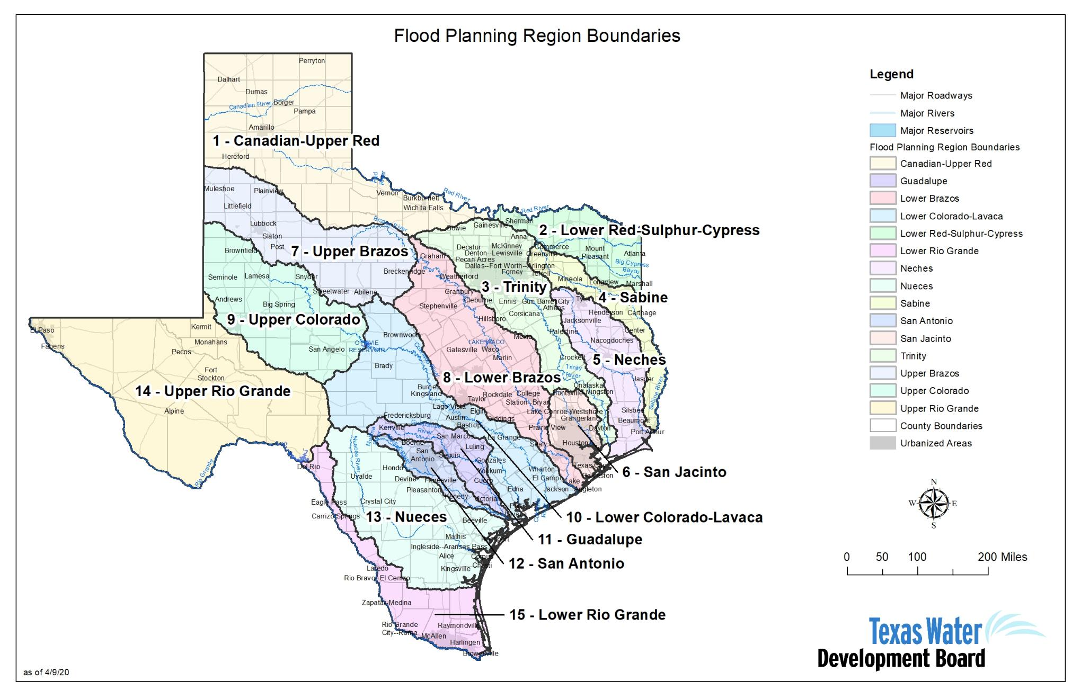
TWBD State Flood Planning

Slide 4
Key Regional Flood Planning Tasks
Flood Hazard Analysis Determine location, magnitude, and frequency of flooding
Flood Exposure Analysis
Identify who and what might be harmed
Flood Risk
Identify specific flood risk
Set flood protection goals
Identify and recommend flood mitigation studies and projects
Public Participation
Vulnerability Analysis Susceptibility, critical facilities, resilience

Slide 5
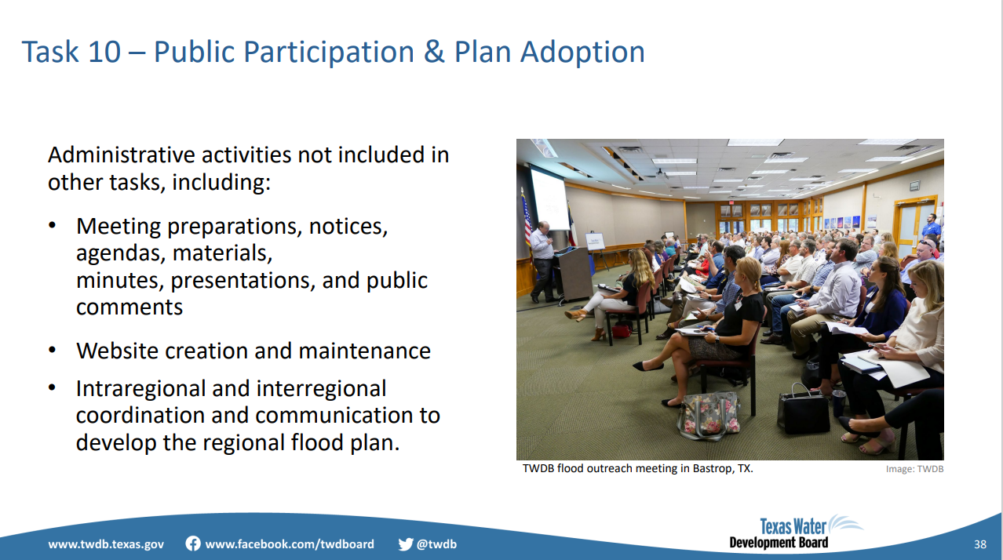
Public Participation Perspective

Slide 6
State Flood Plan Updates
2024 State Flood Plan
  Consolidating 2023 Regional Flood Plans
  Due September 1, 2024
2029 State Flood Plan (2028 Regional Plans)
  October 5, 2023
  Amended the Regional and State Flood Planning Rules
  November 9, 2023 (pending board approval)
    2nd Cycle RFP Funding
    2nd Cycle Request for Grant Applications
    2nd Cycle Draft Scope of Work

Slide 7
Importance of Public Engagement
"I have lived on the Guadalupe River since I was 8 years old and have dealt with it's flooding for years, I'm 72 now. For the protection of our homes, animals, human lives, our businesses... we must improve things!"
Region 11 Flood Risk Summary | Existing 1% Flood Event (100-yr)
Total Area of Flood Hazard Risk | > 980 square miles
Agricultural Land at Risk | > 680 square miles
Total Structures at Risk | > 45,000
Residential Structures at Risk | > 32,000
Critical Facilities at Risk | > 200
Roadway Stream Crossings at Risk | > 3,150
Population at Risk | > 117,000
NFIP Claims (1975-2021) | > $261 Million

Slide 8
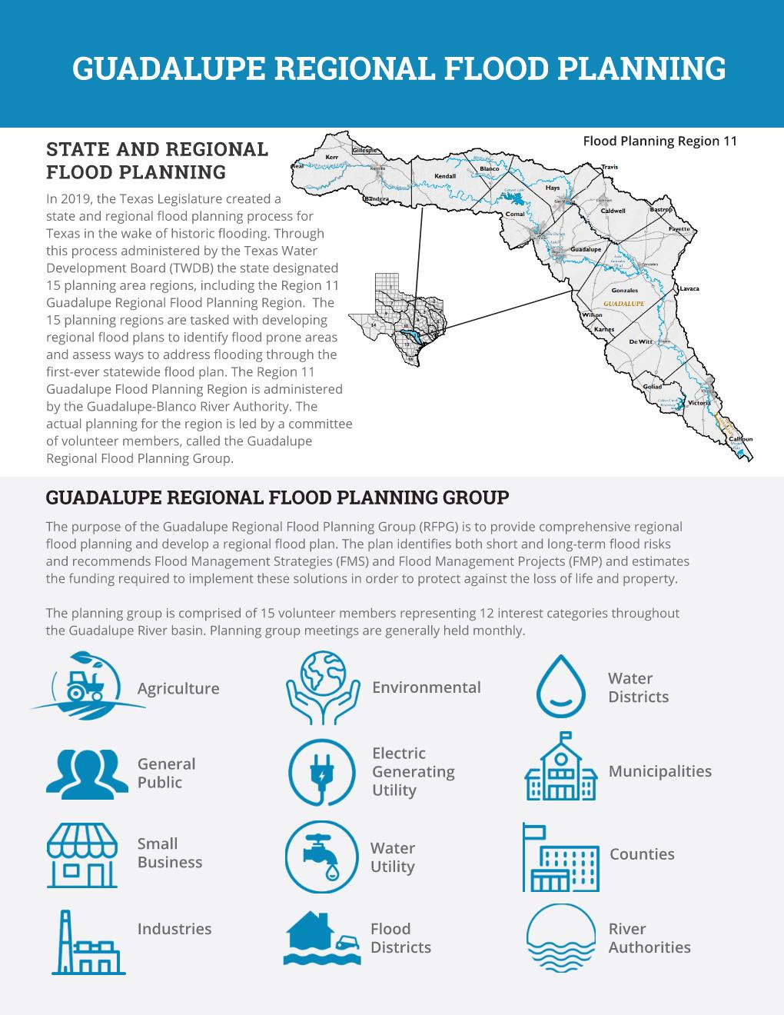
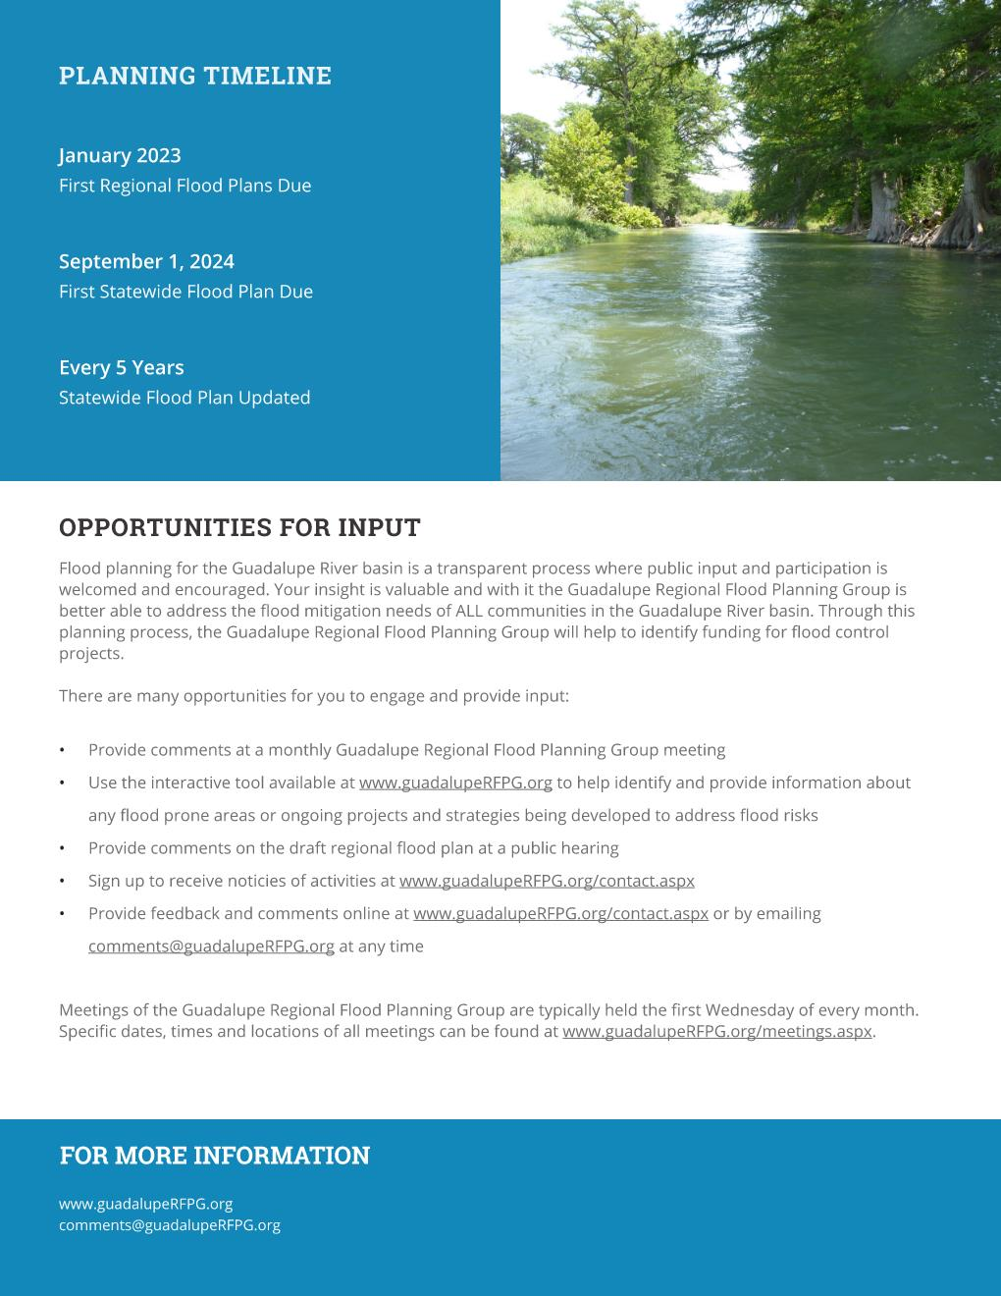
GBRA Public Outreach Initiatives

Slide 9
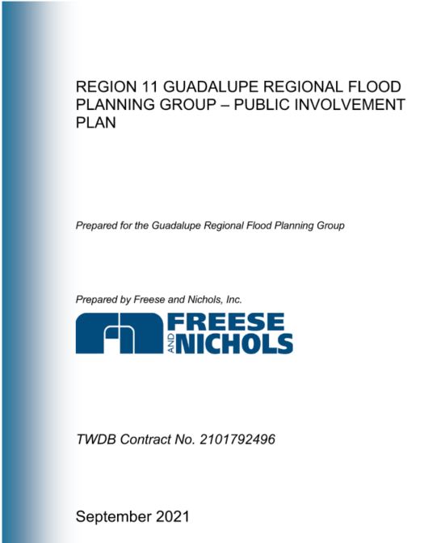
Who is the Public and How did Region 11 Engage?
CATEGORIES
PUBLIC and PRIVATE Stakeholders Anyone with a role in flood risk reduction, Anyone with flood risk, and Anyone who may benefit from risk reduction Elected Officials, City/County Engineers, Flood Plain Administrators, General Public, Non-Profits, etc.
STRATEGIES
Public and Private Stakeholder List | Virtual Public Meeting
Interactive Mapping Tool and Surveys | Comment Tracking, Response, and Reporting
Dedicated Website and Email | One-Page Educational Handout
Social Media

Slide 10
Was the Outreach Successful?
Public Engagement
30+ Public Meetings
2 Pre-Planning Meetings
2 Draft Plan Public Meetings
3 Final Plan Public Meetings
38 Completed Surveys
Targeted Media Advisories
600+ Individuals on Contact List
Able to reach small communities (online or in-person)
Additional Meetings in Wimberly, Victoria, Kerrville
Planning Group Outreach/Activities
  New Braunfels Chamber
  Texas State Student Activities
  Social Media and Outreach

Slide 11
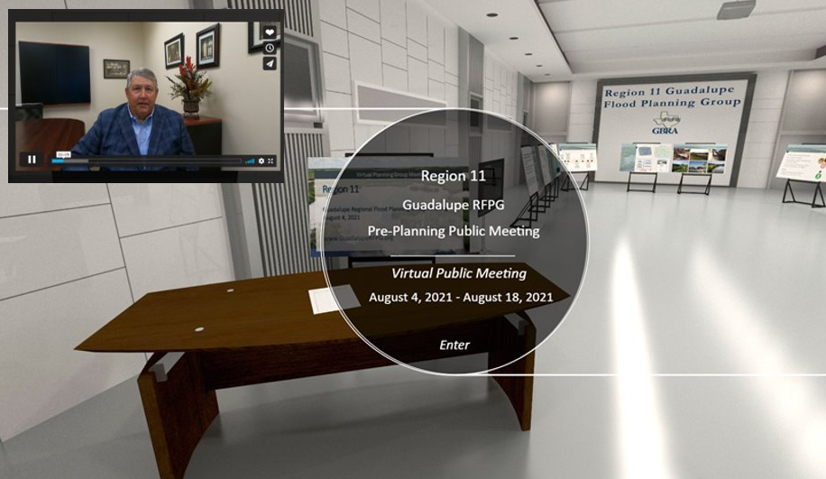
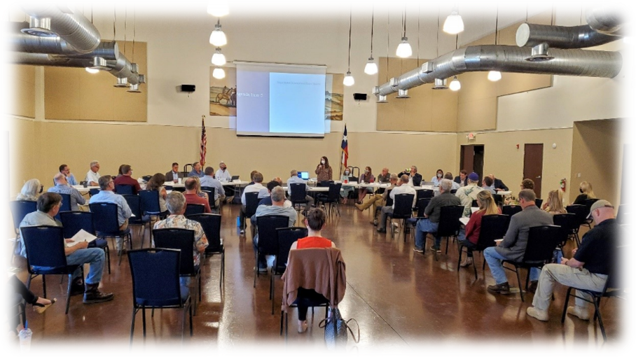
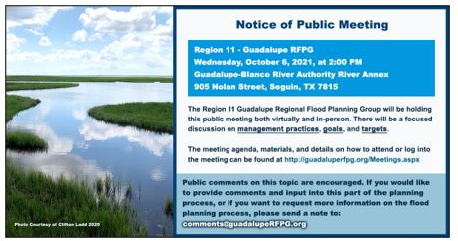
How was Region 11 Outreach Similar or Different?
Virtual meeting
Menti Meter
Dashboard
Lessons Learned:
  ?
  ?

Slide 12
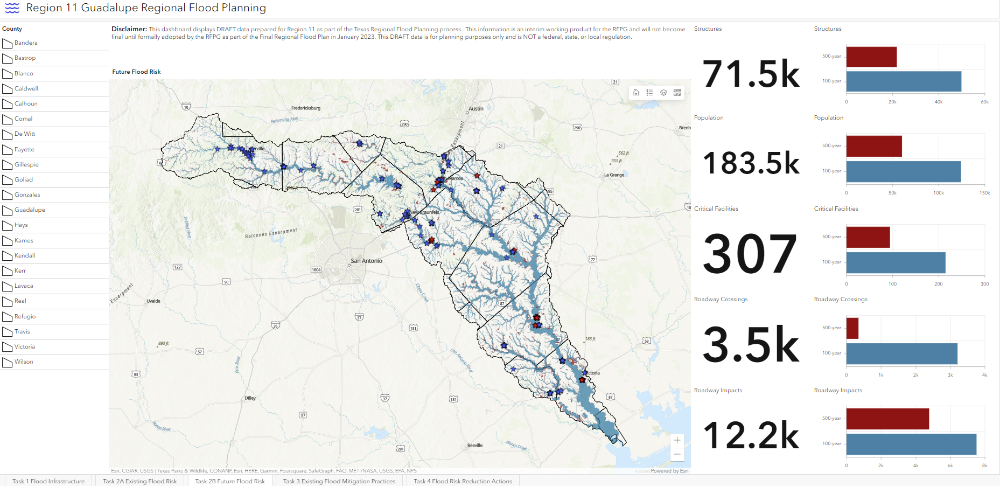
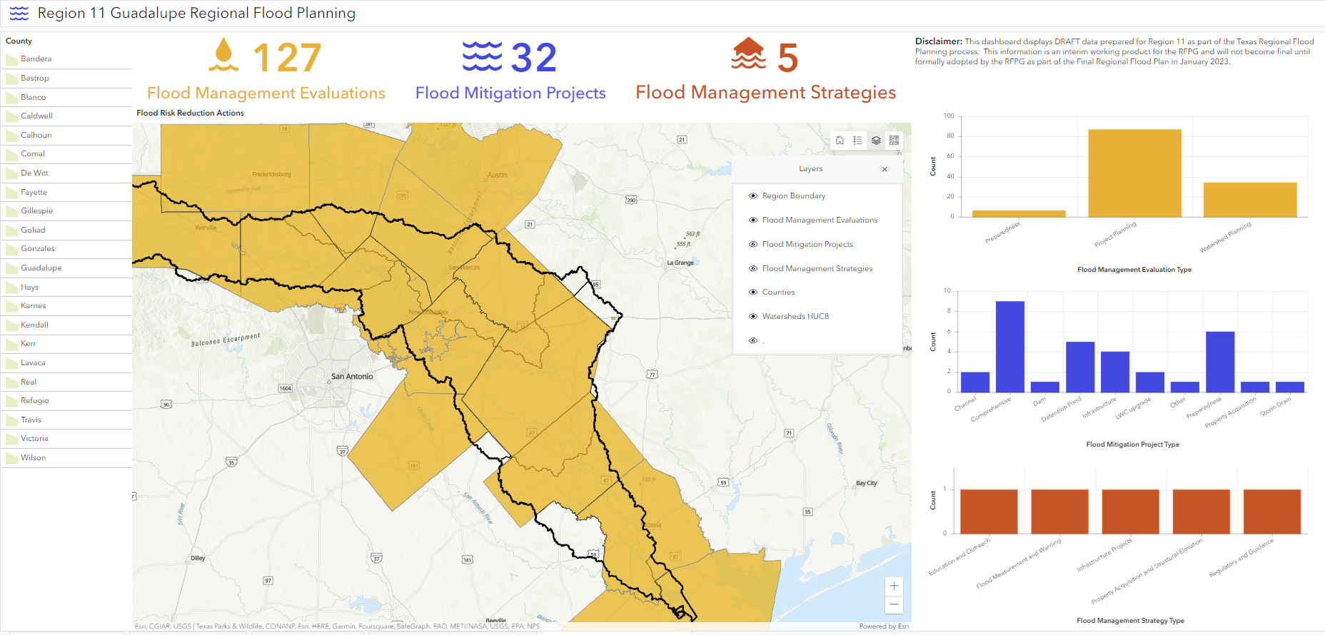
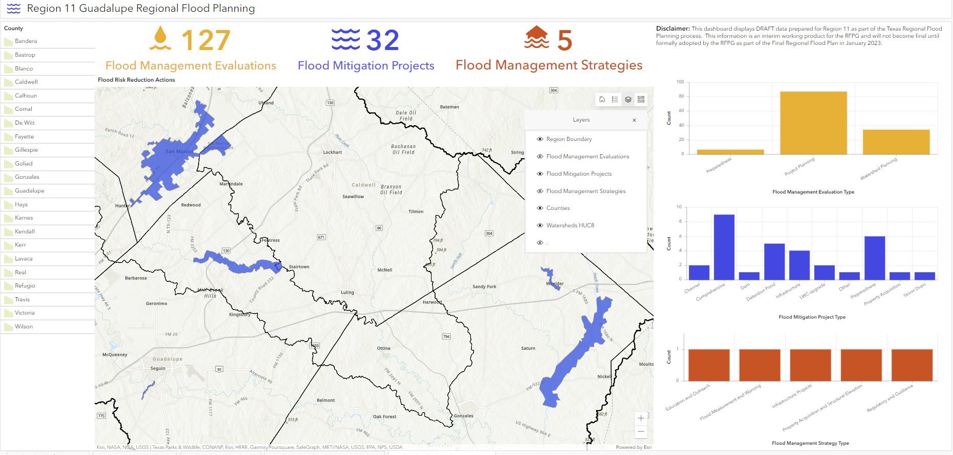
How was Region 11 Outreach Similar or Different?
Virtual meeting
Menti Meter
Dashboard
Lessons Learned:
  ?
  ?

Slide 13
Did the Public Involvement Plan Work?
Public Engagement
80+ Attendees at Pre-Planning and Draft Plan Public Meetings
125+ Attendees (Virtual Public Meeting)
35 - 45+ Attendees at Monthly Regional Flood Planning Meetings
60+ Webmap Entries
100+ Suggestions/Recommendations from General Public

Slide 14
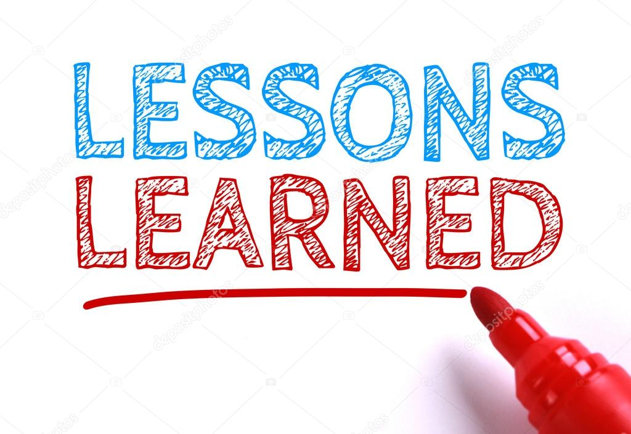
Lessons Learned and Second Cycle Changes?

Slide 15
For more information
Visit the Region 11 Website:
www.GuadalupeRFPG.org
Email Region 11:
Comments@GuadalupeRFPG.org
Signup for TWDB Newsletters:
FloodPlanning@twdb.texas.gov

Slide 16





Next Steps for TWDB
July 2023
Amended Regional Plans
September 2024
State Flood Plan
Future State Financial Assistance

